Slide 1
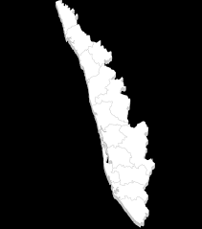
KERALA
industry,
investment,
opportunity

Slide 2
INDIA – EMERGING AS A HUB FOR GLOBAL GROWTH
Indian economy grew by 7.3% in 2014-15
Estimated to grow by 8-8.5 percent in the current fiscal
Initiatives like Make in India have put the country in the world map as an emerging investment destination

Slide 3

MAKE IN INDIA
On the threshold of major reforms India is poised to become the third-largest economy of the world by 2030
India-The nEXT MANUFACTURING DESTINATION

Slide 4

Kerala
“A State Like No Other”
100% LITERATE.
100% DIGITAL.
100% ENTERPRISE READY.

Slide 5
Investment destination
Top tourist destination in the world
Has emerged as a premier investment destination in India
International submarine cable landing points for unparalleled connectivity
First state in India to be fully covered by broadband connectivity under NOFN
KOCHI Metro - in it’s completion stage
18 Sea Ports, 3 Intermediate Ports, 14 Minor Ports
1 International Seaport and ICT Terminal at Kochi close to Trans national trade corridor
Rs 7,525 crore investment Vizhinjam Port Project. by Adani group in Kerala
Upcoming Kannur International airport project-only state to have four
International airports
First phase of Smart City IT park, Kochi in completion stage
India’s first Defence park to be established in Kerala

Slide 6
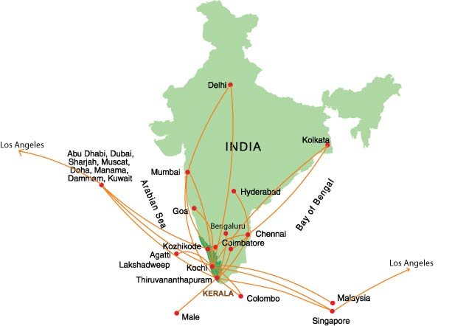
  Connected to Middle East, South East Asia
  17 international airlines & 4 domestic airlines operate to Trivandrum Airport
  20 international airlines & 7 domestic airlines to Cochin
  10 international airlines & 4 domestic airlines operate to Calicut
  NH network of 1523 km, State Highway of 4655 kms
  Intricate network of roads and canals connect even the remotest part

Slide 7
WHAT MAKES KERALA THE BEST CHOICE FOR YOU?
Urban state: Most urbanized states in India with growth rate of 6.49%, which is above the national average of 4.04%.
Skilled manpower:
150 engineering institutes with more than 50000 intake capacity, 49 polytechnics colleges with 10000 intake capacity.
33%
Working population
Highest Human Development Index (HDI) in India

Slide 8
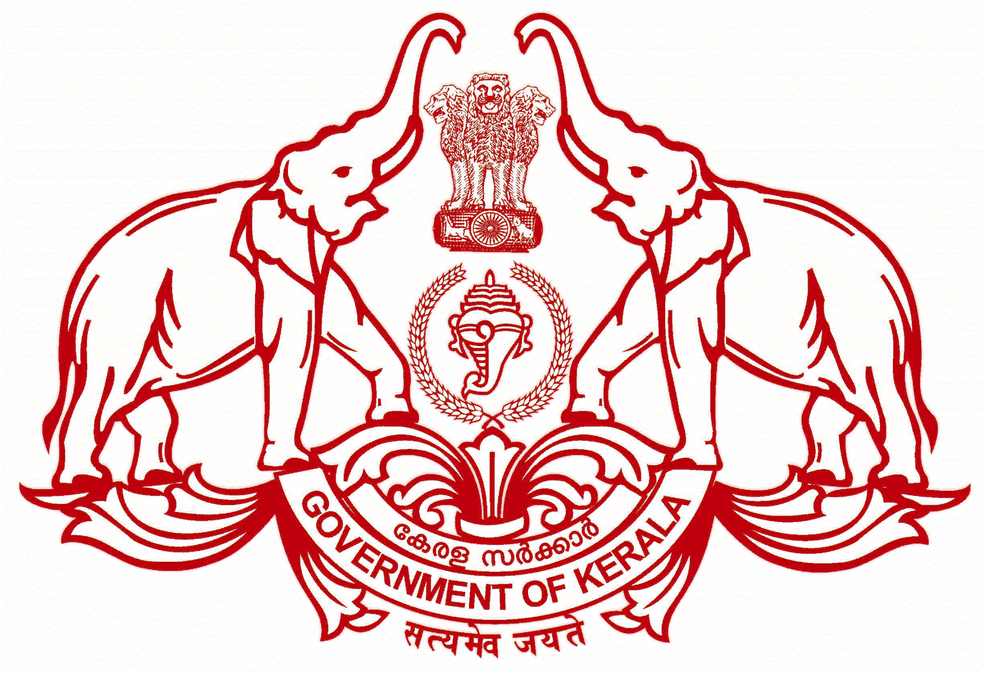
INDUSTRIAL FRIENDLY POLICIES BY
GOVT. OF KERALA
Promoting industrial growth has been the main agenda of the Government. To realize this cause, the Government has formulated a range of policies like:
Industrial and commercial policy
Tourism Policy
IT Policy
Student Entrepreneur Policy
Technology Start up policy
Labour Policy
Smart Hydro Power Policy

Slide 9
FOCUS SECTORS IN KERALA
Tourism
Electronics
Food processing
Healthcare
IT/ITES
Green energy
Port Development

Slide 10
Kerala, India’s Tourism Superbrand
India’s only Tourism Superbrand, selected by the Superbrand Council
India’s No.1 upscale tourist destination
One of the 10 must-see destinations of a lifetime – “National Geographic Traveler”
International Tourist Arrivals 9,23,366
Tourist arrivals from UK 1,59,669
8.3% growth in 2014 over 2013
Source: Research Division, Dept. of Tourism, Kerala

Slide 11
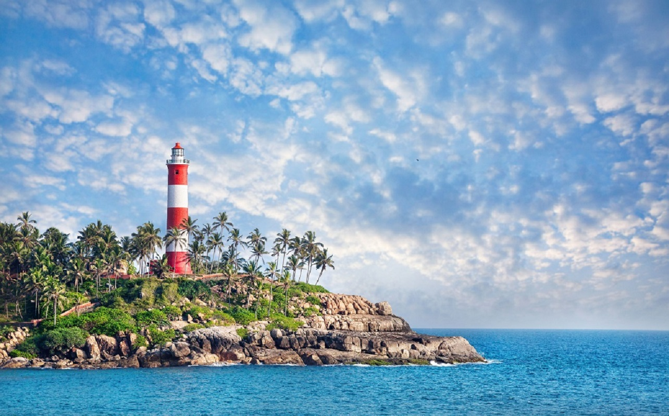
Kovalam – Poovar Corridor
Major Investment Projects in PPP model
  Water Sports facilities including Scuba diving in 5 different spots ( Expected investment – 10 Cr)
  Conversion of Vattappara quarry as an adventure destination with bungee jumping, rappelling and a suspended restaurant ( Expected investment – 10 Cr)
    Entertainment zone ( Amusement Park / Gallery/ Oceanarium/ Sand sculptures etc) at Poovar Estuary
    (Expected investment - 50 Cr)

Slide 12
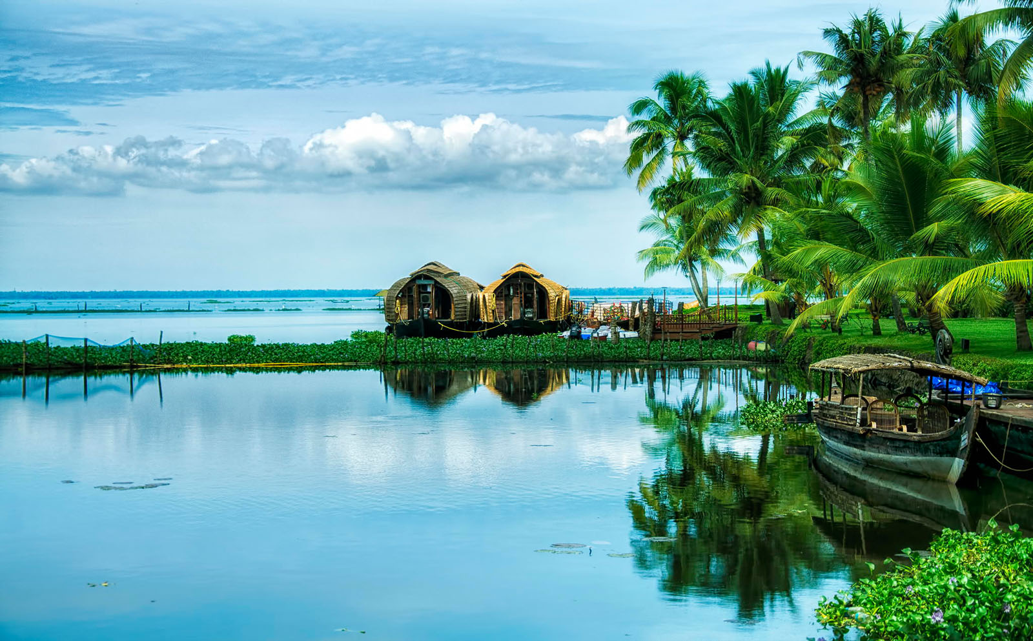
Destination - Kumarakom
Favorite holiday destination of Celebrities
Houseboats with over night stay facilities

Slide 13
Kumarakom – Major Investment
Projects in PPP Model
  Convention Centre for MICE tourism (Expected investment – 50 Cr)
  Cultural Handicrafts Village ( Expected investment – 10 Cr)

Slide 14
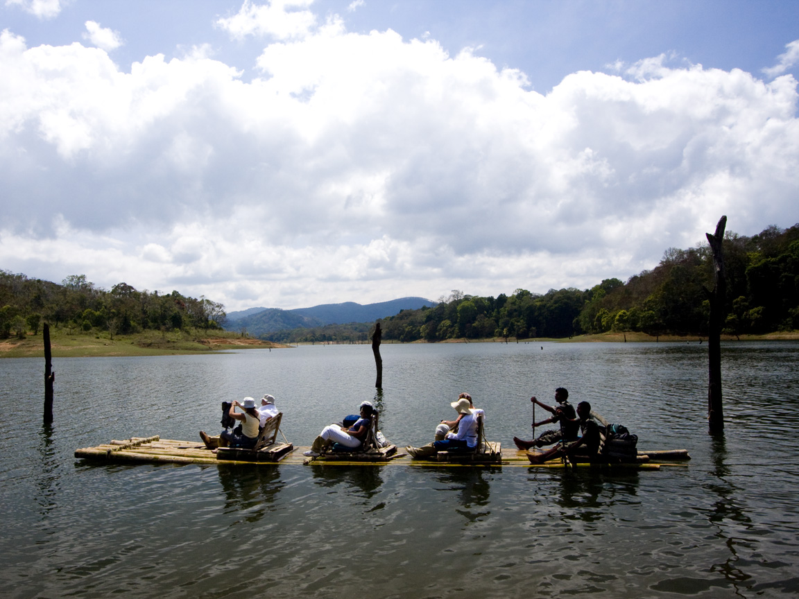
Destination - Thekkady
Thekkady – Major Investment
Projects in PPP Model
  Alternate Transport Modes ( Battery Operated Vehicles) for Tourist transport
  Tourist rest areas and toilet facilities
  Floating area
  Rock garden and recreational facilities at Urumbikkara
One of the finest wildlife reserves in India

Slide 15
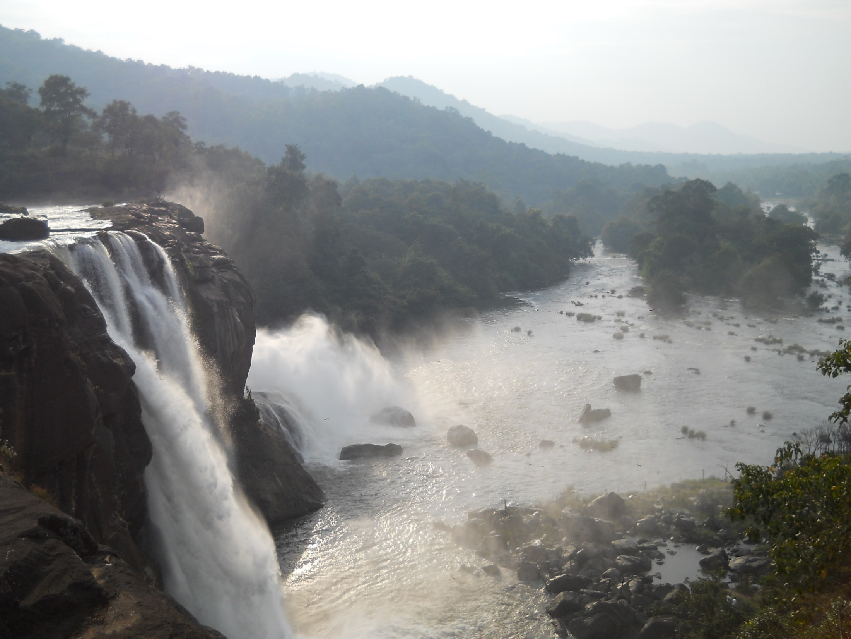
Potential Investment Destinations
Athirapally Waterfalls

Slide 16

Potential Investment Destinations-Wayanad

Slide 17

Potential Investment Destinations
Bekal Fort

Slide 18
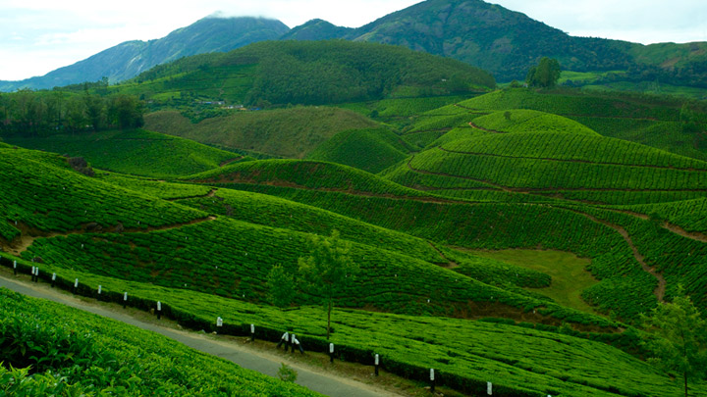
Potential Investment Destinations
Munnar

Slide 19
HIGH END ELECTRONICS
Why Kerala?
Land Bank Availability
Research institutes
Electronic manufacturing companies
Processing Zone – Industrial Plots, Manufacturing & Support Facilities
Logistical/Transportation facilities
150 engineering institutes with 50000 intake capacity every year, 49 polytechnics with 10000 technically qualified students pass out
Skilled manpower

Slide 20
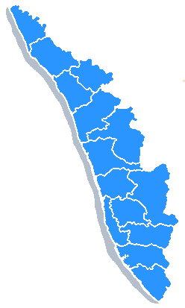
Infrastructure availability for High End Electronic
ESDM Policy– assistance to set up new Greenfield and up gradation of Brownfield Electronic Manufacturing Clusters
  Brownfield Electronic Manufcturing Cluster in Kannur, Ernakulam and Trivandrum Kerala
NeST Group – 35 acres of electronics cluster (SEZ) in KINFRA Hitech Park, Ernakulam, Kerala
  Greenfield Electronic Manufacturing Cluster at 64 acres KINFRA Park, Ernakulam, Kerala

Slide 21
UPCOMING PROJECTS
Defence Industrial Park,
Palakad, Kerala
Electronic Hardware Park,
Ernakulam, Kerala
State of the art Electronic Incubator
Cochin, Kerala

Slide 22
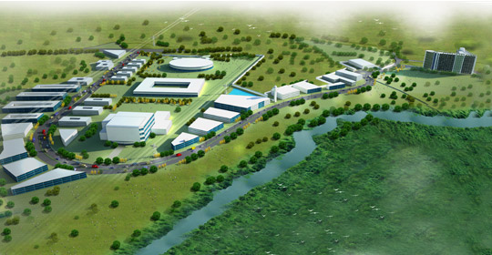
ELECTRONICS MANUFACTURING CLUSTER AT KAKKANAD, ERNAKULAM

Slide 23


FOOD AGRO PROCESSING
The state accounts for nearly 20% of country’s food export.
Why Kerala?
Area under cultivable waste has also increased by 24155 ha. and barren and uncultivated land declined by 332 ha. respectively
Established network of research institutions and universities providing specialized courses related to food
Kerala is a major producer/processor of
Spices
• Marine Products
• Cashews
• Coconuts
• Cocoa, Coffee and Tea
• Fruits like jackfruit, banana and pineapple

Slide 24
Upcoming projects
Mega Food Park,
Cherthala, Kerala
Mega Food Park,
Palakkad, Kerala

Slide 25
WELLNESS / HEALTHCARE INFRASTRUCTURE
medical tourism industry in Kerala is expected to be worth a staggering $4 billion by 2017
Why Kerala?
Long before the world woke up to Ayurveda, it was a way of life in Kerala
Of all the places on earth there is just one that is literally shaped by a tradition of Ayurveda which goes back to thousands of years
Organized health care in Kerala can be traced back to the missionary hospitals that made in-roads in remote, interior parts of the state
State of the art hospital and research institute
Medical tourists from developed countries of the world like US and Switzerland visit the state’s Ayurveda hospitals
CII-McKinsey report

Slide 26
FACILITY AND INFRASTRUCTURE AVAILABLE
  More than 25 super specialty hospitals, 15 medical colleges in the private sector and 8 Medical colleges and 4 Dental colleges in government sector
  Kerala - India’s best healthcare indices - well accepted by public
  High per capital healthcare expenditure- 3.684 USD per month on health care and in urban areas spending is 4.15 USD by people in Kerala
  Health tourism - a fast emerging sector
  R&D facility, para medical and nursing institutions & medical device manufacturing

Slide 27
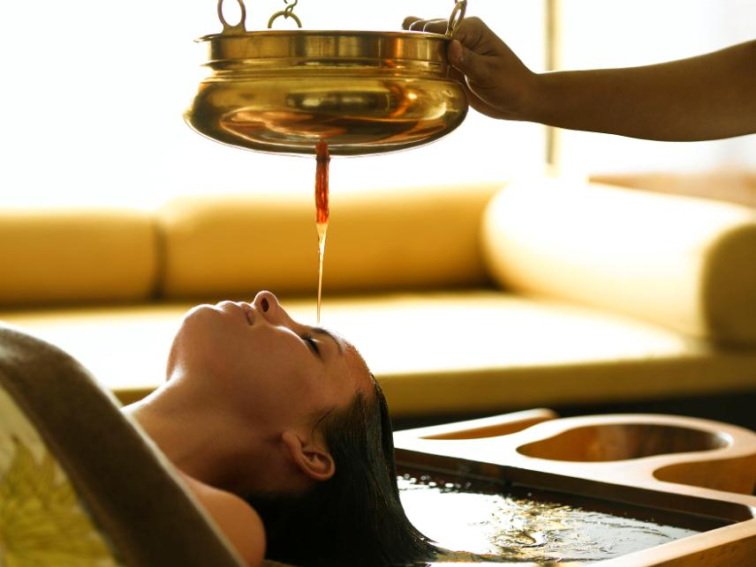
More than 12,000 Ayurvedic doctors

Slide 28

750 Dispensaries
800 registered Ayurveda medicine manufacturing units

Slide 29
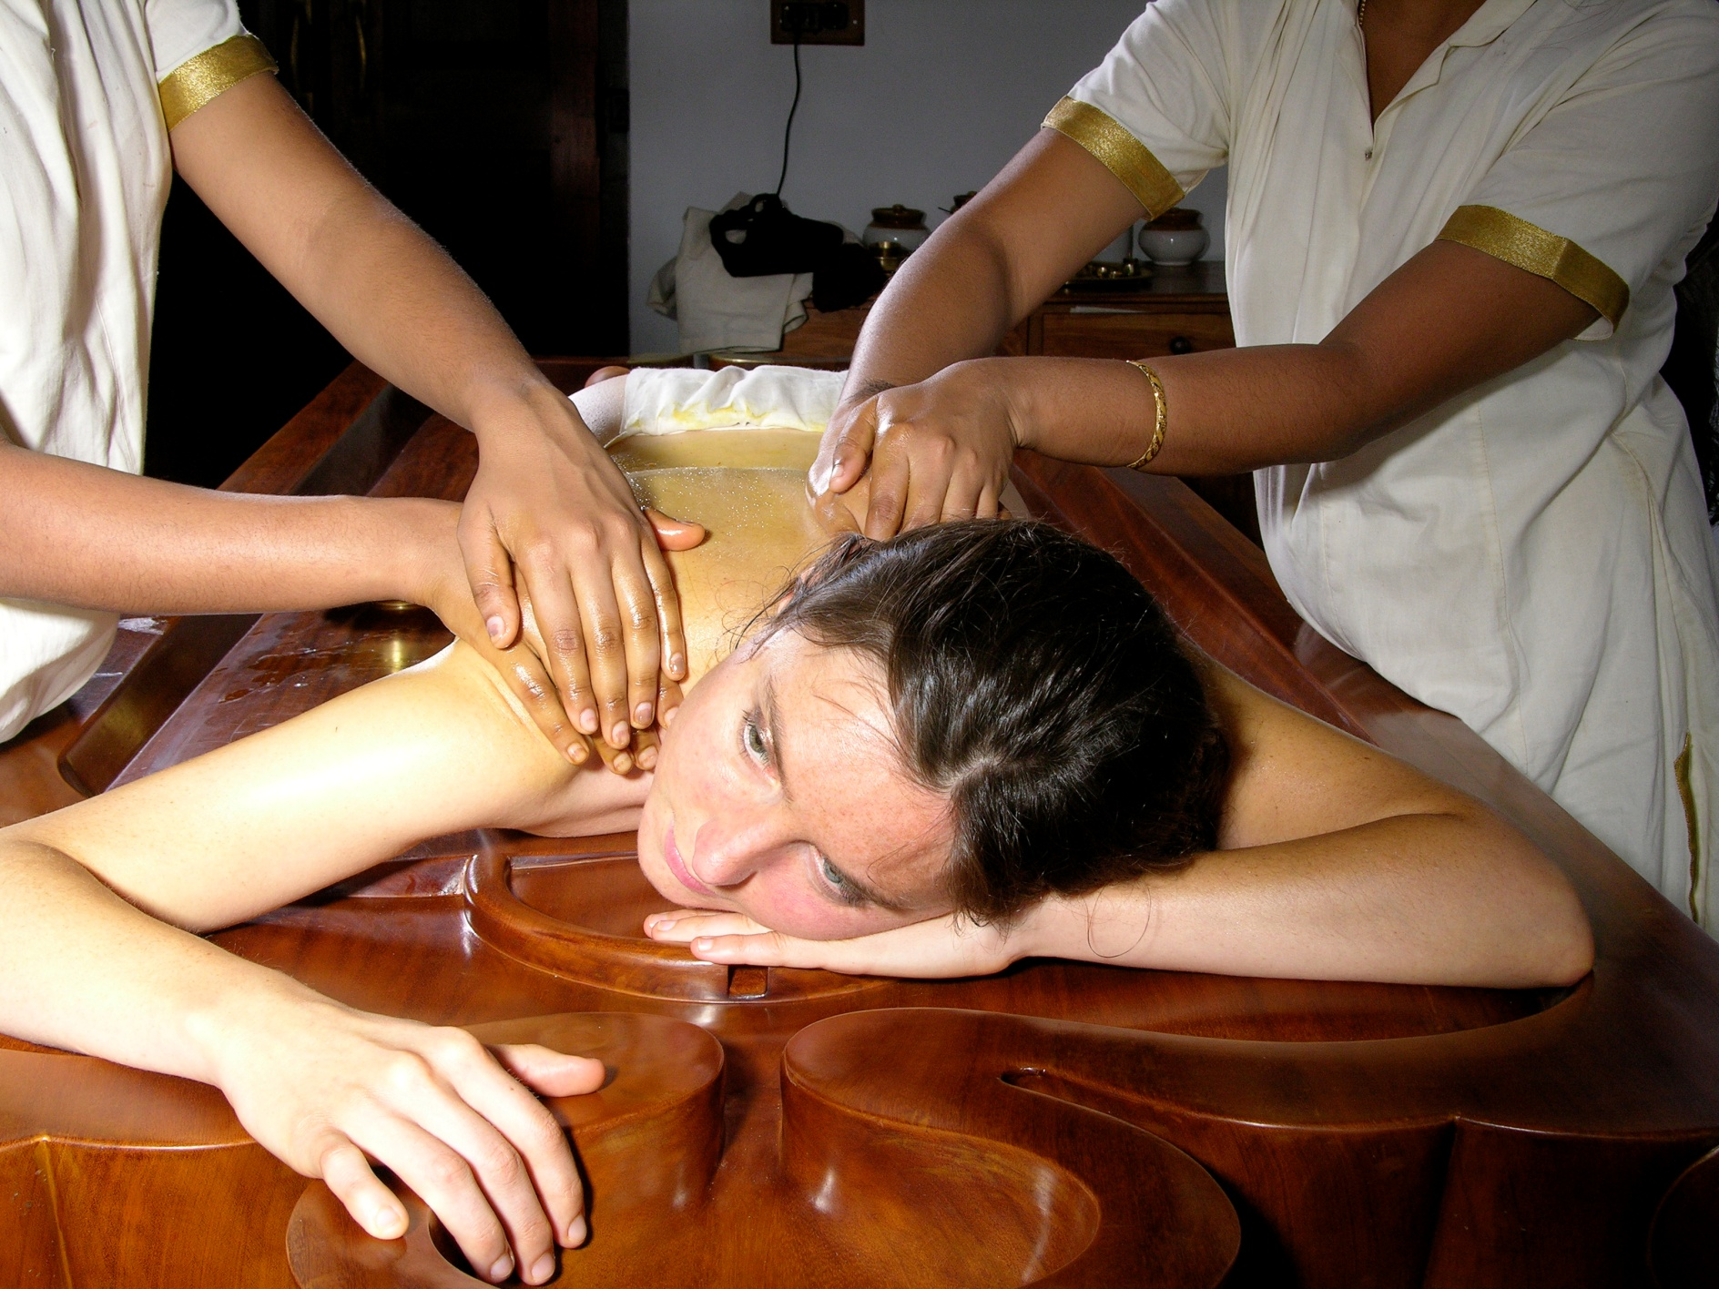
Over 100 Government-run Ayurveda hospitals with 2700+ beds

Slide 30
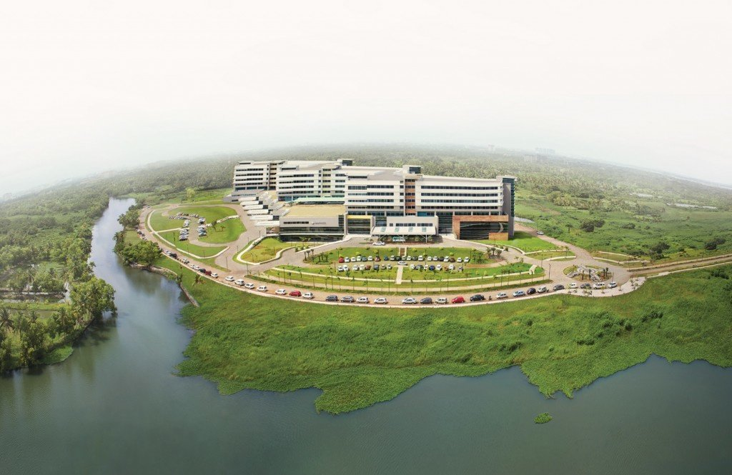
Aster Medicity- A state of the art infrastructure

Slide 31
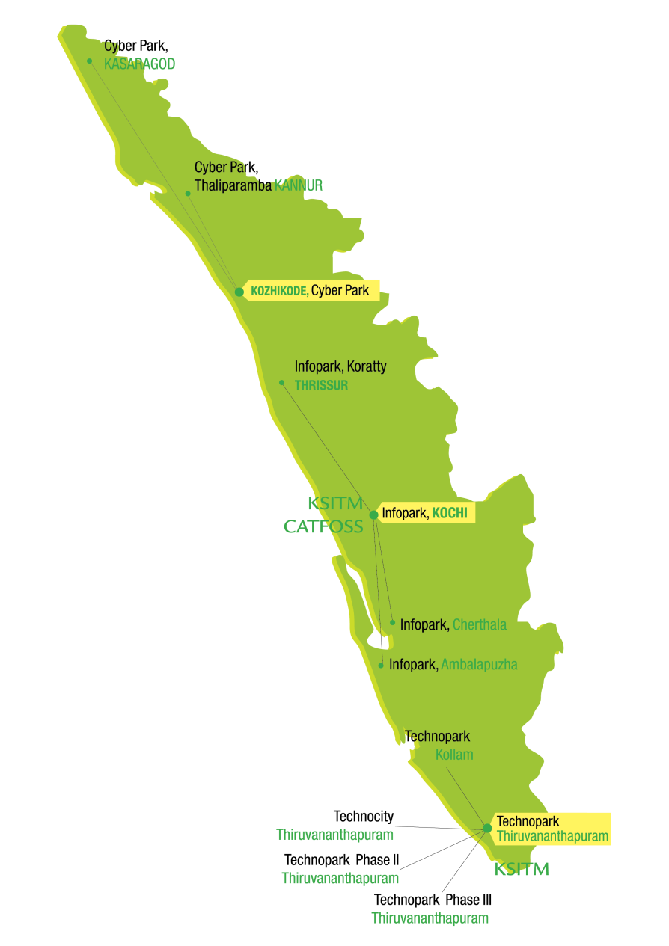
IT / ITeS
State with the best information infrastructure – fully wired
The most digital state in the country – effective e-governance system in majority of departments
IT Parks at three cities(Trivandrum, Kochi & Kozhikode)
and at smaller towns, employing around 75,000 – 80,000
IT professionals
  Technopark, Trivandrum (333 acres, 85 lakhs sq.ft.);
  Kundara (44 acres, 2 lakhs sq.ft.) 330 IT/ITeS Companies,
  46000 IT/ITeS professionals
  Infopark, Kochi (254 acres, 65 lakhs sq.ft.); Cherthala
  (66 acres, 2.4 lakhs sq.ft.); Thrissur
  (30 acres, 3.3 lakhs sq.ft.), 200 IT companies,
  24000 IT professionals
  Cyberpark, Kozhikode (42 acres, 3 lakh sq.ft.);
  Kannur (25 acres) & Kasaragod (100 acres) under construction

Slide 32
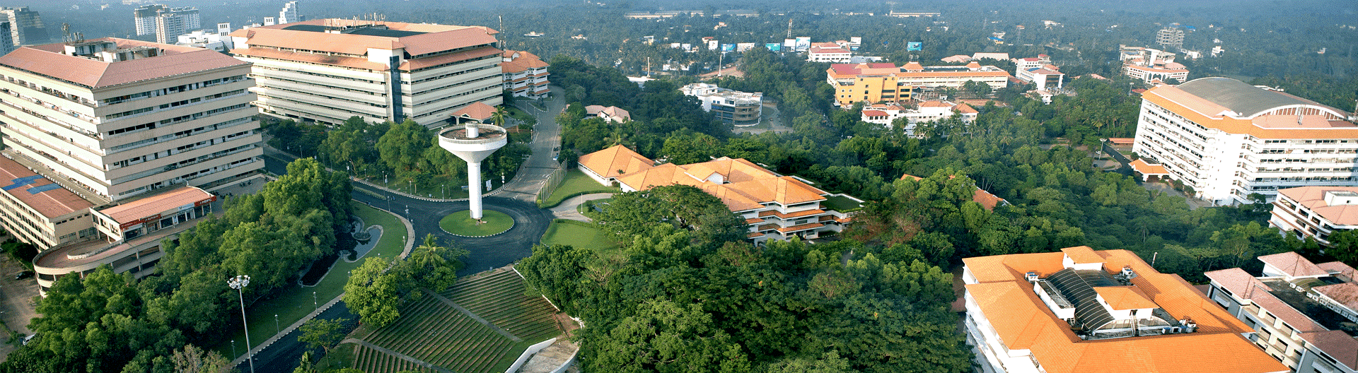
TECHNOPARK, INDIA’S FIRST IT PARK

Slide 33
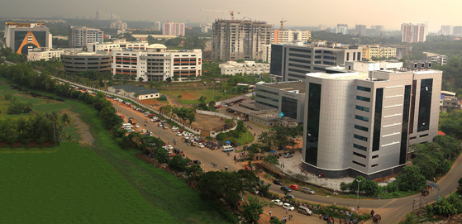
INFO PARK-KOCHI

Slide 34
SMART CITY KOCHI
Smart city with 8.8 million sq ft of built- up area, will house firms from information and communication technology(ICT), media, finance and research and innovation cluster, from India and abroad
SCK plans to commission the entire project by 2020
SCK also entered into agreement for joint development with leading IT, hospitality, reality and education companies to make the hub here and integrated township having facilities for love, work and play
Smart City Kochi will be the largest IT and IT-enabled infrastructure SEZ in the country

Slide 35
100% Digital State
First 100% digital state in India
Broadband connectivity in every villages
Various e services under project Akshaya- with an objective to make at least one member in each of the 64 Lakh families e-Literate
WiFi Hotspots at all local self-Government institutions
Implementation of mobile governance across the whole state
Optimal utilization of Central Govt.’s ‘Bharat Net’ project, which will spread Internet across each and every household, with an average speed of 2MBPS to 20 MBPS.

Slide 36
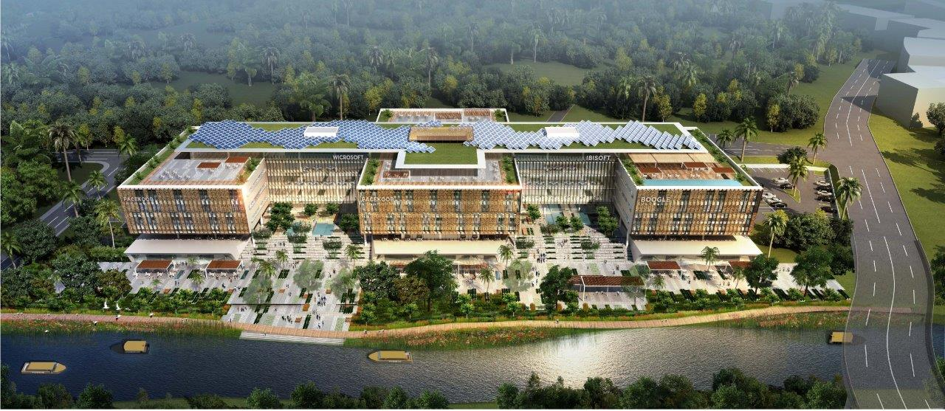
Smart City Kochi 01 Office Block

Slide 37


Projects on the Anvil
  Free Trade Warehousing Zone (FTWZ)
  Redevelopment of Q1 - Q3 Berth

Slide 38
Free Trade Warehousing Zone (FTWZ)
Cochin Port Trust (CPT) has been given in-principle approval by Govt. of India for developing an FTWZ on 102 acres (41 Hectares) of land on Willingdon Island
Willingdon Island also offers excellent connectivity by means of road and rail. Cochin International Airport is located just 35kms from Cochin Port.
CPT has been declared as developer of Cochin Port FTWZ.
The co-developer is expected to develop the FTWZ on DBFOT basis.
Cost of project estimated at Rs.5000 million.

Slide 39
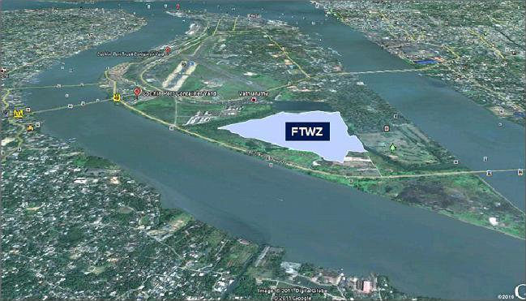
FTWZ Location

Slide 40
Redevelopment of Q1 - Q3 Berth
Cochin Port Trust intends to award on PPP basis a project for the redevelopment of Q1-Q3 berth on Mattancherry Wharf on the western side of Willingdon Island.
The quay length is around 400m.
The berth has a backup area of approx. 18 acres (7 hectares).
Currently the area has 6 godowns with a combined area of 18,000 sq m.
The assets will be transferred in as-is-where-is condition to the successful bidder.
The concession period shall be for thirty years.

Slide 41
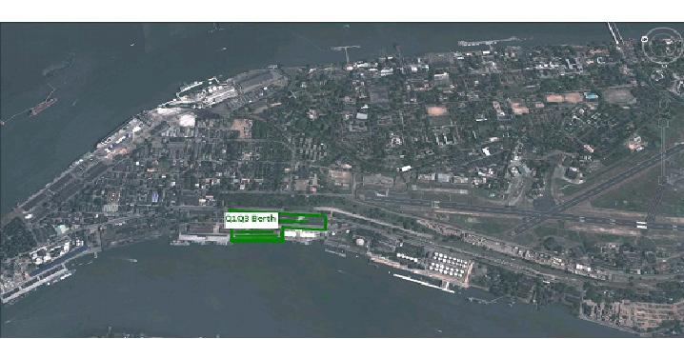
Q1-Q3 Berth Location
Ariel view of the location

Slide 42
Sustainable Green Mobility
  Kerala thus intends to pitch aggressively for 100% eV mobility by 2030 to tackle this issue
  5000 state transport buses and 16000 privately owned buses cater to the transportation needs of the public
  The State owned electricity utility is power surplus and has own generation of above 30% from clean hydroelectric projects
  About 5000 state transport buses and 16000 privately owned buses cater to the transportation needs of the public

Slide 43
ACTION PLAN
  JBM motors, India
  has already nformed
  us that they are
  unveiling their eBus
  at the Delhi Auto
  show in February
  Ecofriendly zero emission electric bus transit system is proposed
  Existing buses are planned to be phased out and replaced by eBus in five years
  Utility is vibrant and has a proactive outlook to propelling the construction of charging infrastructure to systematically keep pace with powering the 100% electric mobility goal of the state

Slide 44
China being our neighbor with substantial knowhow and credibility in this sector we invite you to partner with Kerala in its Electric mobility development by setting up manufacturing base in Kerala

Slide 45

KINFRA PARKS
22 Theme based Parks Completed
Apparel Park,Trivandrum
Export Promotion Park-Kakkanad
Film & Video Park,Trivandrum
Food Processing Park,Malappuram
Neo Space, Kakkancherry
Small Industries Park, Trivandrum
Food Processing Park, Adoor
Small Industries Park,Kunnamthanam
Hi-Tech Park,Kalamasserry
Small Industries Park, Nellad
Small Industries Park, Koratty
Small Industries Park, Wayanad
Small Industries Park, Thalaserry
Small Industries Park, Kasaragod
Textile Centre,Nadukani
Industrial & Textile Park,Palakkad
SEZ for Animation,Gaming/IT/ITES
Expansion of Apparel Park under APES scheme
International Animation School,Film & Video Park, Trivandrum
Rural Apparel Park, Rajakumari
Bio-Technology Park,Kalamaserry

Slide 46

KINFRA PARKS
Joint Venture Projects
Rubber Park, Irapuram
Sea Food Park, Aroor
Western India KINFRA Ltd,Kanjikode
KINESCO,Kakkanad
Inkel-KINFRA Infrastructure Limited
CaRE Keralam

Slide 47
PROJECTS ON THE ANVIL

Slide 48

PROJECT 1 - MEGA FOOD PARK
Ministry of Food Processing Industries, Govt. of India has accorded “Final Approval” for setting up KINFRA Mega Food Park at Palakkad.
78 acres of land earmarked in Palakkad for the proposed project.
3 vital components
    Central Processing Centre (CPC)
    Primary Processing Centers (PPCs)
    Collection Centres (CCs)
Total cost of Rs. 121.92 crores

Slide 49
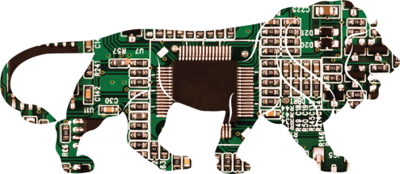
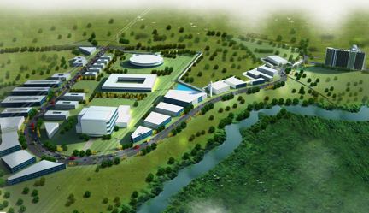

PROJECT 2 -ELECTRONIC MANUFACTURING CLUSTER (EMC)
66.87 acres of land earmarked at Kakkanad.
Central Assistance from Ministry of Communication and Information Technology (DeiTY), Government of India, under Electronic Manufacturing Cluster Scheme.
Project components:
  Processing Zone - Industrial Plots, Manufacturing & Support Facilities Complex
  Non Processing Zone – Residential Plots, Commercial
  Utilities
  Physical infrastructure and
  Logistical/Transportation facilities
Total project cost of Rs. 155.76 Crores

Slide 50

PROJECT 3 – KINFRA DEFENCE PARK
India’s first Government of India approved Defence Park, in 60 acres in Palakkad.
Target industries – Defence related equipments and ancillaries.
Based on the Modified Industrial Infrastructure Upgradation (MIIU) scheme, implemented by Department of Industrial Policy and Promotion (DIPP).
Total project cost of Rs. 231.35 Crores.

Slide 51

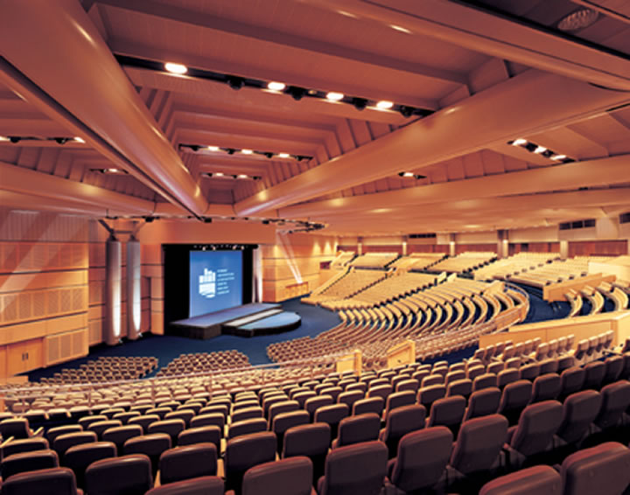
PROJECT 4 - INTERNATIONAL EXHIBITION CUM CONVENTION CENTRE (IECC)
15 acres earmarked, which is close to Infopark and Smart City, at Kakkanad, Kochi.
To be implemented by KINFRA in association with ITPO with financial support from Government of India and Government of Kerala.
Project components:
  Exhibition Halls
  convention and conference halls
  theatres
  cafeteria
  open air exhibition space
  material storage and handling space etc.
  Total project cost of Rs. 164 Crores.

Slide 52
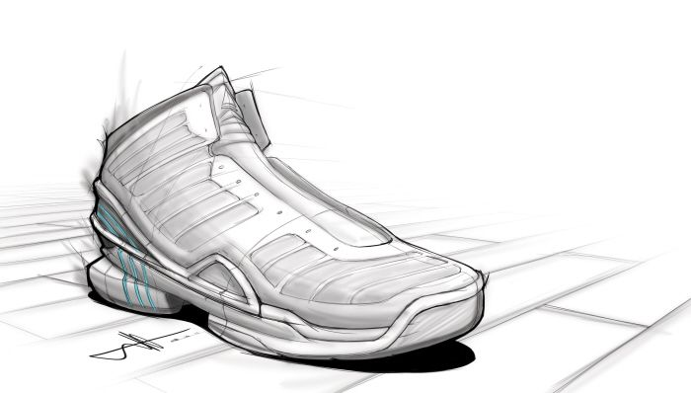

PROJECT 5 - FOOTWEAR PARK
30 acres of land in Ramanattukara at Kozhikode district.
Department of Industrial Policy and Promotion (DIPP), under the guidelines of Indian Leather Development Programme (ILDP), have initiated the Mega Leather Cluster sub-scheme
Target Industries (Non-Leather):
  Non leather manufacturers
  Allied products
  Packing materials
Total project cost of Rs. 107 Crores

Slide 53


PROJECT 6- GLOBAL AYURVEDA VILLAGE
Government of Kerala initiated PPP model project.
An area of 7.50 acres identified at Thonnakal.
Major components:
  Ayurveda wellness zone like wellness units, herbal garden etc.
  Human resource development, digital library, international academy
  R& D coordination
  Centre of clinical excellence like surgical complex, yoga, meditation and physiotherapy centre etc.
Total project cost of 32.5 Crores

Slide 54

Brings together Investments & Industry
in Kerala
since 1961

Slide 55
KSIDC has been setting the agenda of Kerala’s industrial growth and driving it by:
Identifying suitable investment sectors and ideas
ONE STOP
SHOP
Financial Assistance
Support to young entrepreneurs and start-up ventures
Translating ideas into concrete proposals
Industrial and Infrastructure development
Women entrepreneurship Development
Studying Feasibility and Evaluating Projects
Investment Promotion Initiatives
Sector Development Initiatives
Financial Structuring, Loan Syndication – Term Loan, Equity & Equipment loan
Assisting in Govt. Clearances
Handholding projects till completion

Slide 56
WORLD CLASS ECOSYSTEM FOR LIFE SCIENCES IN THE MAKING IN THIRUVANANTHAPURAM..

Slide 57
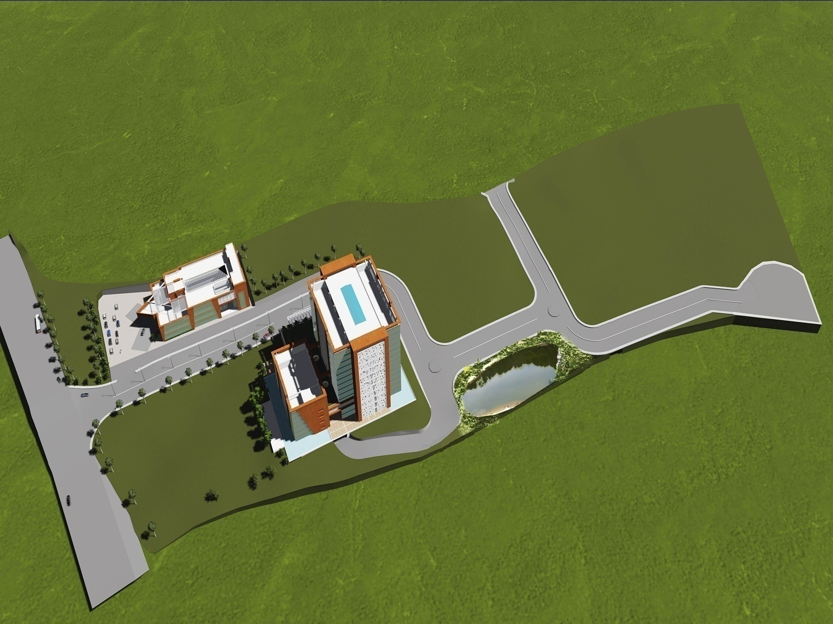

Slide 58
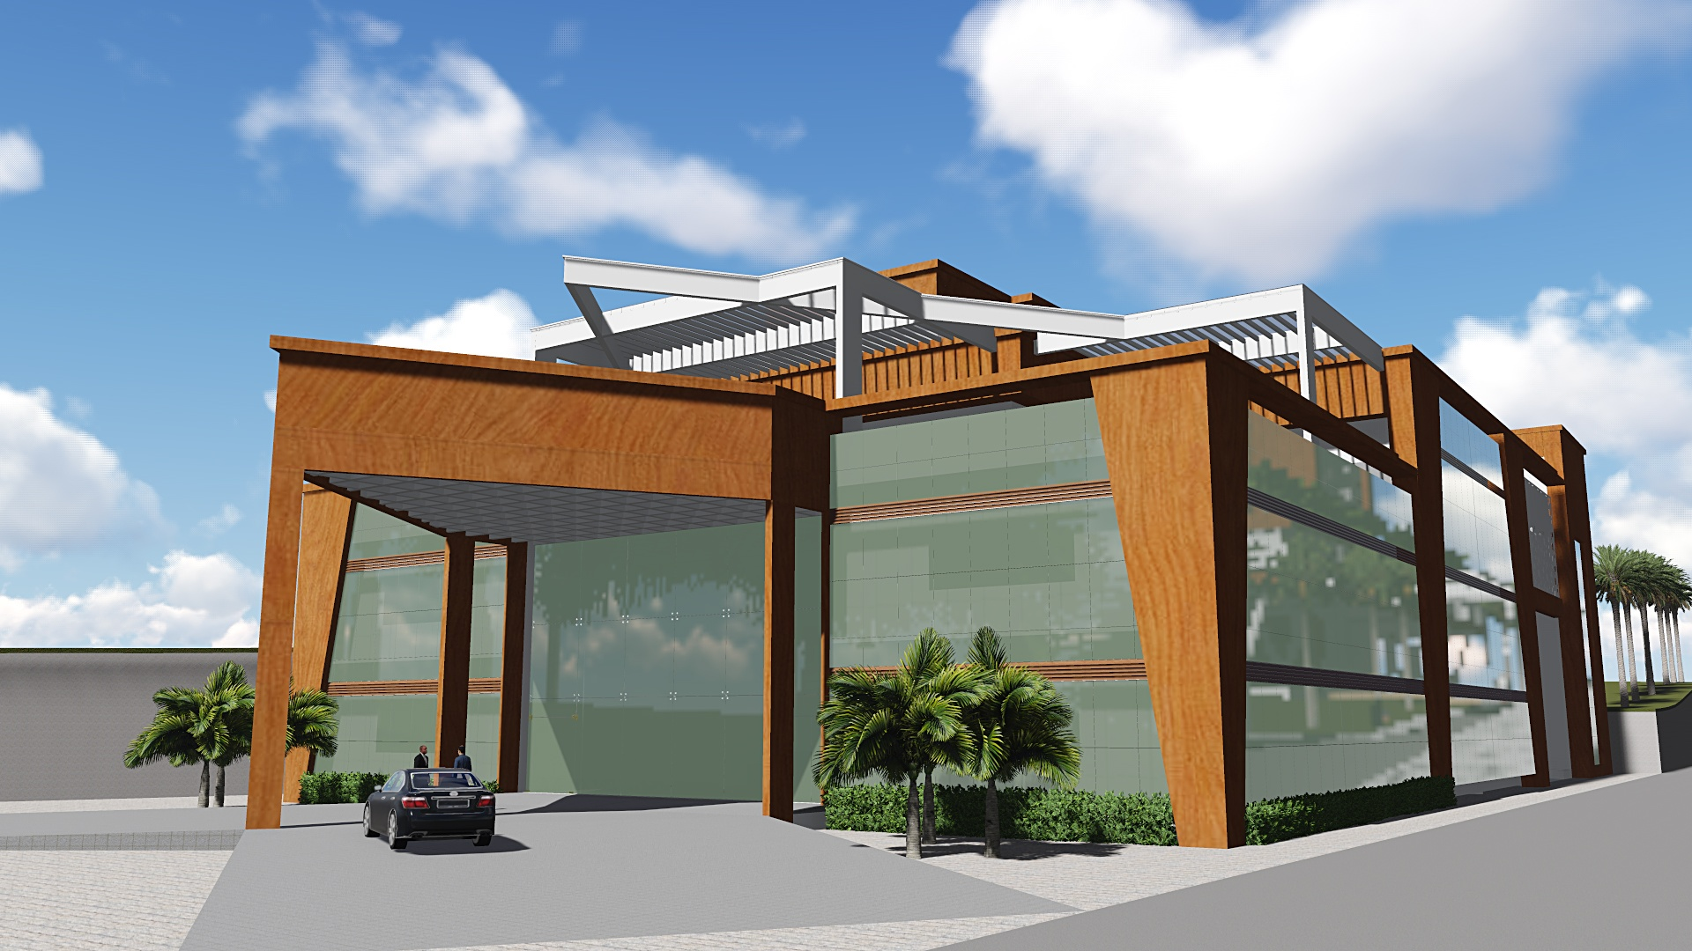

Slide 59
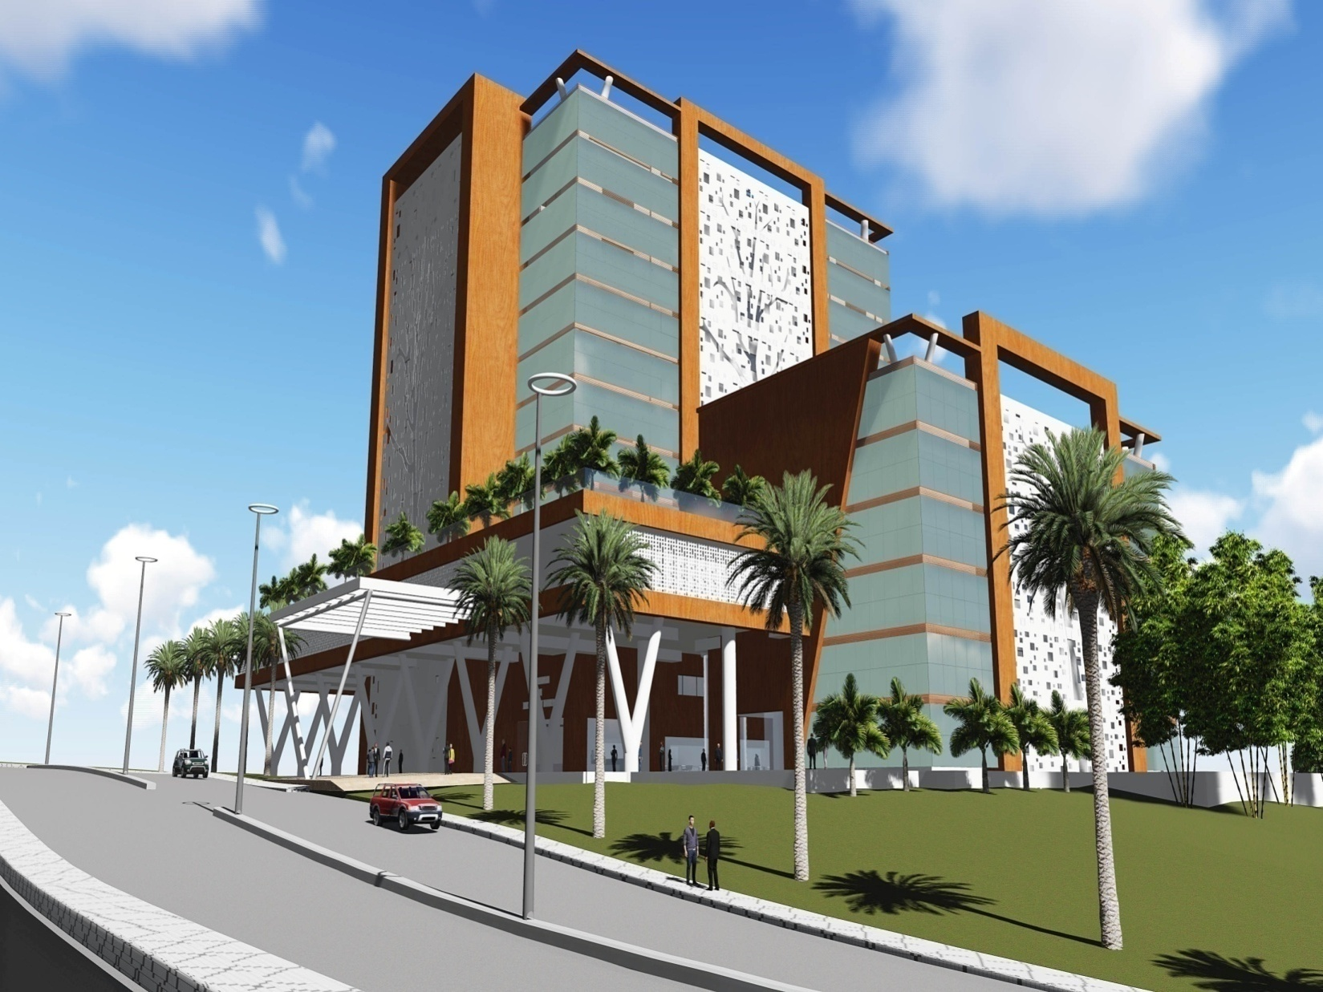

Slide 60
Website: www.ksidc.org
Tel: 0471-2724812 iickerala@ksidcmail.org
KERALA STATE INDUSTRIAL DEVELOPMENT CORPORATION LIMITED
PARTNER WITH KSIDC

