Slide 1


Slide 2
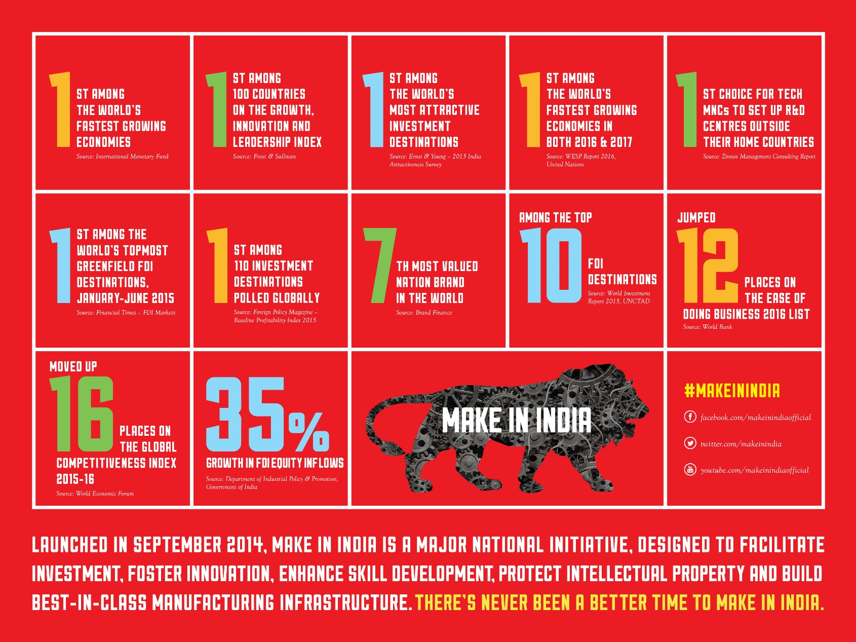
9

Slide 3
Make in India Week

Slide 4
OBJECTIVES
SHOWCASE+CONNECT+COLLABORATE
Showcase potential of design, innovation and sustainability and sense of pride in Indian manufacturing
Connect with global industry leaders and administrators
Collaborate to take corporate and public participation to the next level
MAHARASHTRA is the partner State for the Make in India Week

Slide 5
MAKE IN INDIA CENTRE
The Centre will feature exhibition of most innovative products and manufacturing processes that have been developed in India
The Centre will be at MMRDA Grounds, BKC in area of ~ 2,20,000 sq. m with 27 halls
The space itself will be an avant-garde statement in design, merging the aesthetics of traditional craft with a futuristic vision
Large number of visitors registered to be at the Centre everyday
5,000 delegates expected to participate in various seminars at Make in India Centre everyday

Slide 6
MAKE IN INDIA CENTRE – SECTOR AND COUNTRY PAVILIONS
A showcase of 160 global and Indian companies across key focus sectors
11 sector and 2 country pavilions
Sector Pavilion
Defence & Aerospace
(19)
Automobiles & Auto Components
(17)
Chemicals & Petrochemicals
(15)
Construction Equipment, Materials & Technology
(9)
Food Processing
(11)
Infrastructure Development
(8)
IT & Electronics
(12)
Industrial Equipment & Machinery
(23)
Pharmaceuticals
(8)
Textiles
(10)
Micro, Small & Medium Enterprises
(12)
Country Pavilion
Sweden
(11)
Germany
(5)
Korea
(4)
Notes:
Number

Slide 7
MAKE IN INDIA CENTRE – STATES PAVILION
18 STATES – A display of India’s major manufacturing States, their achievements and investment potential
Andhra Pradesh
Jharkhand
Odisha
Rajasthan
Punjab
Chhattisgarh
Haryana
Madhya Pradesh
Bihar
Uttar Pradesh
Maharashtra
Daman & Diu, Dadra & Nagar Haveli
Telangana
Himachal Pradesh
Tamil Nadu
Karnataka
Gujarat
Kerala

Slide 8
INTERNATIONAL PARTICIPATION
Make in India Week is a major diplomatic initiative for global business community that India is a preferred place to do business
Participation of top Government and Industry leaders including large business delegations
An ideal platform for bilateral meetings, business-to-business, business-to-government meetings

Slide 9
INTERNATIONAL PARTICIPATION
Large industry delegations from 45 countries confirmed till date
High level dignitaries participating:
Prime Minister of Finland
Prime Minister of Sweden
Prime Minister of Lithuania
Deputy Prime Minister of Poland
Parliamentary State Secretary, Ministry for Economic Affairs and Energy, Germany
Director General, UNIDO
Special Advisor to the Prime Minister of Japan
Commerce Minister, Kuwait
Minister of Transportation, the Republic of Indonesia
Minister of Trade, Industry and Tourism, Columbia
Mayor of Pohang, South Korea
Minister of Trade of Venezuela (TBC)

Slide 10
MAKE IN INDIA WEEK EVENTS
CNN Asia Business Forum
Time India Awards
21 Sector Specific Seminars
9 State Investor Summits
Driving Innovation: Hackathon
Make in India: The Way Forward
Conference on Empowering Through Design
The Global Design and Innovation Session
Champions for Societal Manufacturing

Slide 11
CNN ASIA BUSINESS FORUM
This will bring together leading minds from across the world to discuss potential for growth and business in Asia
CNN anchors Fareed Zakaria, Richard Quest and Andrew Stevens will lead a series of interviews and debates
Experts from Industry and Institutions will explore new ideas, technologies and leadership skills that will shape Asia's economic and social future

Slide 12
TIME INDIA AWARDS
A panel of elite judges will determine the winner in the three categories:
  Best-in-class Manufacturing Award
  Award for Innovation
  Young Makers Award
The shortlist will be released at the World Economic Forum in Davos on 21st January 2016
Final Awards would be presented by Prime Minister on 13th February 2016 at Mumbai
TIME will host panel discussions that explore the different facets of innovation, entrepreneurship and intelligent manufacturing

Slide 13
SECTOR SPECIFIC SEMINARS
21 sector specific seminars
Conceptualized and led by the key Union Ministries
Will be addressed by Union Ministers, Think Tanks, Industry Leaders, Academic Institutions, Industry Associations
Showcasing investment opportunities in each sector, recent policy initiatives for attracting investments and ease of doing business

Slide 14
STATE INVESTOR SUMMITS
9 States showcasing:
Key sectoral strengths with reference to investment opportunities
Steps undertaken by the State government to improve business environment
Locational advantages, industrial infrastructure availability
Large projects implemented/planned, success stories
Investor Summits will be led by respective Chief Ministers
Gujarat
Andhra Pradesh
Jharkhand
Odisha
Punjab
Chhattisgarh
Haryana
Madhya Pradesh
Maharashtra

Slide 15
DRIVING INNOVATION: HACKATHON
IIT Bombay is coordinating a Hackathon with young coders, engineers and designers from leading institutions to solve urban design problems in three important areas i.e. – Water, Transportation and Energy
Workshop followed by Hackathon would commence from 9th February at IIT Campus
Out of 131 registrations 30 teams (10 for each theme) announced for Hackathon
Jury for Hackathon would consist of experts from IIT, successful start-ups and angel investors
Winners of this event will present their ideas during the Make in India Week
An industry-academia interaction would also be arranged featuring manufacturing success stories

Slide 16
MAKE IN INDIA: THE WAY FORWARD
A platform for interaction of industry leaders, policymakers and key players to be organised to assess impact of Make in India
Familiarizing delegates with Government of India’s Initiatives
  Make in India
  Digital India
  100 Smart Cities
  Skill India
Charting the direction and the next steps to help further the impact of Make in India

Slide 17
CONFERENCE ON EMPOWERING THROUGH DESIGN
Discuss design concepts and sustainable design advantage for India
Indian and international designers, design practitioners, thinkers, corporates, media leaders, government and academia to participate
Mumbai Design Trail to focus on unique design offerings in selected galleries, outlets, cultural centers and artist studios

Slide 18
THE GLOBAL DESIGN & INNOVATION SESSION
A day-long session with founders of leading brands, key decision makers and experts from the fields of architecture, management, fashion and cinema
Focus will be on knowledge sharing, entrepreneurial attitudes, creative benchmarks and industry trends to create opportunities

Slide 19
CHAMPIONS FOR SOCIETAL MANUFACTURING (CSM)
The session focus is on discussions related to strategies which would revolutionize manufacturing industry in India.
Main themes for this session:
Design led manufacturing
Voluntary way for scaling 1000 Visionary Small & Medium Enterprises (VSME)
Village Buddha as a way to integrate the CSM thinking into the way villagers are engaged
Women in manufacturing

Slide 20
PORT OF CALL
An exhibition of India’s maritime design & manufacturing capabilities featuring the Navy’s latest indigenous technology
Live demonstration at the dockyard featuring indigenous design and manufacturing capabilities utilised in naval ships and submarines
Performance by Naval Band at Gateway of India followed by Heritage Walk at Naval dockyard for international delegates

Slide 21
MUMBAI TAKEOVER
Exhibitions across all museums and art galleries in Mumbai
Music, street art, sound and light shows, interactive digital displays and lion installation across Mumbai
Art and culture shows - 35 events planned in collaboration with the Government of Maharashtra and Ministry of Culture, Government of India
A street food festival that brings to plate the local cuisine of the city

Slide 22
MAKE IN INDIA WEEK – WEBSITE
Dedicated website to the event – Make in India Week
Online registration for visitors and exhibitors
Online management of B2B / B2G meetings via CII platform
Mobile app for instant update to registered users

Slide 23
OTHER DELIVERABLES
Commercial deals announcements by Union Ministries, States
Publication “Investment Opportunities in India” – listing of projects ready for investments and visionary upcoming projects in the next 3-5 years by the key Union Ministries and States
Publication “Marquee Investments” – investments announced across various sectors of the Indian economy since the launch of Make in India Initiative
Publication “It happens only in India” – demonstration of India’s unique manufacturing capabilities
Make in India Magazine – Special issue with help of professional cameraman travelling across the country to capture and showcase India’s most creative and dynamic innovators and entrepreneurs across various industries

Slide 24
PROPOSED ENGAGEMENT OF PM DURING MAKE IN INDIA WEEK
Inauguration of the Make in India Centre at MMRDA Grounds, BKC, Mumbai starting at 11:00 AM on 13th February 2016
Launch of the Make in India Week at National Sports Centre of India (NSCI), Worli, Mumbai starting at 05:10 PM on 13th February 2016.
Attend “India Evening”: Reception hosted by the Chief Minister of Maharashtra at Turf Club, Worli, Mumbai starting at 07:30 PM on 13th February 2016
Bilateral meetings with Prime Ministers of various countries attending Make in India Week on 13th/ 14th February at Mumbai.

Slide 25


Slide 26
Backup slides for reference

Slide 27
CONFIRMED UNION MINISTERS – MAKE IN INDIA WEEK
Mrs Nirmala Sitharaman (Ministry of Commerce & Industry)
Mr Piyush Goyal (Ministry of Power, Coal, New & Renewable Energy)
Mr Ravishankar Prasad (Ministry of Communication & Technology)
Mr Anant Gangaram Geete (Ministry of Heavy Industries and Public Sector Enterprises).
Mr Santosh Kumar Gangwar (Ministry of Textiles)
Mr Dharmendra Pradhan (Ministry of Petroleum and Natural Gas)
Mr Nitin Gadkari (Ministry of Road Transport and Highways)

Slide 28
CONFIRMED STATE CHIEF MINISTERS – MAKE IN INDIA WEEK
Haryana – Shri Manohar Lal Khattar
Chhattisgarh – Shri Raman Singh
Odisha – Shri Naveen Patnaik
Maharashtra – Shri Devendra Fadnavis
Gujarat – Smt. Anandiben Patel
Andhra Pradesh- Smt. N. Chandrababu Naidu
Jharkhand – Shri Raghubar Das
Punjab – Shri Prakash Singh Badal
Madhya Pradesh – Shri Shivraj Singh Chouhan

Slide 29
CONFIRMED SPEAKERS – ASIA BUSINESS FORUM
George Yeo Yong-Boon, Chancellor , Nalanda University
Kevin Rudd, Former Prime Minister of Australia
Anand G. Mahindra, Chairman of Mahindra Group
Kunal Bahl, CEO of Snapdeal

Slide 30
CONFIRMED SPEAKERS – THE GLOBAL DESIGN & INNOVATION FORUM
Ms. Ritu Beri (Founder, The Luxury League)
Mr. Patrick Thomas (Ex-CEO, Hermes International)
Mr. Sunil Alagh (Founder – SKA Advisor Pvt. Ltd., India)
Mr. Ravi Capoor (CEO – IBEF)
Ms. Brune Buonomano (Deputy General Director, BETC Luxe)
Sh. Shashi Tharoor (Politician – India)
Mr. Jawhar Sircar (CEO – Prasar Bharti)
Mr. Suhel Seth (Managing Partner Councelage India)
Mr. Francois Richier (French Ambassador)
Mr. Stephane Parmentier (Artistic Director, Christofle, Paris)
Ms. Malavika Sangghvi (Co-founder, Sanguine)
Mr. Manish Arora (Designer, India)
Ms. Bandana Tewari (Fashion Features Director, Vogue, India)

Slide 31
CONFIRMED SPEAKERS –EMPOWERING THROUGH DESIGN
Sadhguru – Yogi, mystic and visionary , Isha Yoga Centre, Coimbatore
Tomek Rygalik – Designer, Curator & Lecturer, Studio Rygalik, Poland
Uli Gwinner – President of Steelcase Asia Pacific, Hong Kong
Satyendra Pakhale – Industrial Designer, Netherlands
Neepa Doshi – Co Founder Doshi Levien, London
Chris Godfrey – Architect & Designer

Slide 32
FINAL JURY – TIME INDIA AWARDS
Norman Pearlstine, Chief Content Officer, Time Inc (Chair)
John Rice, Vice Chairman, GE
Narayana Murthy, Chairman & Co-Founder, Infosys
Kevin Sneader, Chairman, McKinsey, Asia
Carlos Ghosn, Chairman & CEO, Nissan Renault
Chanda Kochhar, CEO, ICICI Bank
Rana Foroohar, Assistant Managing Editor, TIME Magazine

Slide 33
MAKE IN INDIA WEEK EVENTS SCHEDULE
13th February 2016
Forenoon | Afternoon
Inauguration of Make in India Centre by the Hon'ble prime minister of India at MMRDA grounds | Launch of Make in India Week by the Hon'ble prime minister of India at the national sports club of India (NSCI)
14th February 2016
10:00 – 13:00 | 14:00 – 17:00
CNN Asia Business Forum
 | Haryana Investor Summit - 'Happening Haryana'
 | Chhattisgarh Investor Summit
 | Odisha Investor Summit
B2B/B2G/G2G meetings
15th February 2016
10:00 – 13:00 | 14:00 – 17:00
The Global Design & Innovation Session | Seminar on Make in India: way forward
Sectoral seminar on Opportunities in Electronics & IT | Make in Mumbai
Sectoral seminar on Opportunities in Oil & Gas | Sectoral Seminar on Opportunities in Media & Entertainment
Sectoral seminar on Capital Goods and Engineering: Realising the Make in India vision | Sectoral Seminar on Opportunities in Chemicals & Petrochemicals
Sectoral seminar on Opportunities in Power & Coal | Sectoral Seminar on Opportunities in Renewable Energy
Maharashtra investor summit - 'magnetic Maharashtra'
B2B/B2G/G2G meetings

Slide 34
MAKE IN INDIA WEEK EVENTS SCHEDULE
16th February 2016
10:00 – 13:00 | 14:00 – 17:00
Industry-Academia Symposium | Presentation by Hackathon Winners
Sectoral Seminar on Opportunities in Micro, Small & Medium Enterprises (MSME) | Champions for societal manufacturing
Sectoral Seminar on Opportunities in Aerospace & Defence | Sectoral Seminar on Opportunities in Pharmaceuticals
Sectoral Seminar on Opportunities in Food Processing | Sectoral Seminar on Opportunities in Finance & Taxation
Sectoral Seminar on Opportunities in Industrial Corridors | Sectoral Seminar on Opportunities in Railways
Gujarat Investor Summit | Andhra Pradesh Investor Summit
B2B/B2G/G2G meetings
17th February 2016
10:00 – 13:00 | 14:00 – 17:00
Conference on Empowering Through Design
Sectoral Seminar on Opportunities in Roads & Highways | Sectoral Seminar on Opportunities in Ports & Shipping
Sectoral Seminar on Opportunities in Automobiles & Auto Components | Sectoral Seminar on Opportunities in Space Technology
Jharkhand Investor Summit | Sectoral Seminar on Construction Equipment & Construction Technology
Punjab Investor Summit | Madhya Pradesh Investor Summit
B2B/B2G/G2G meetings

Slide 35
MAKE IN INDIA WEEK EVENTS SCHEDULE
18th February 2016
10:00 – 13:00 | 14:00 – 17:00
Sectoral Seminar on Opportunities in Biotechnology | Closing Press Conference
Sectoral Seminar on Opportunities in Textiles
B2B/B2G/G2G meetings

