Slide 1
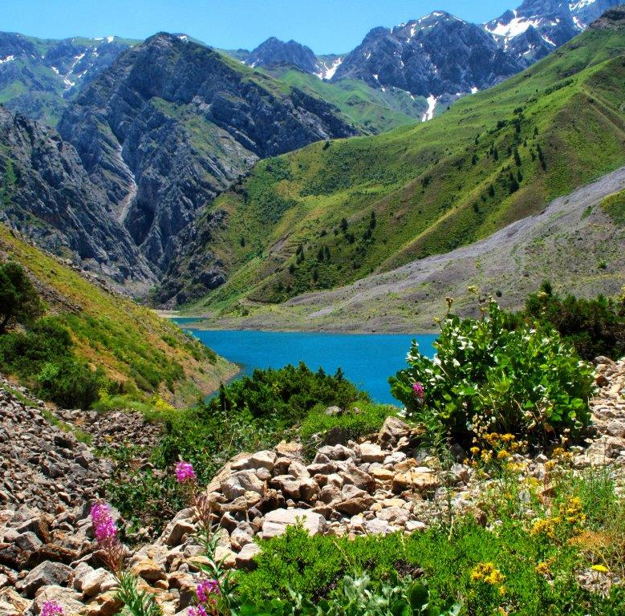
Uzbekistan’s journey of reforms Major reforms in Uzbekistan since 2017. What does this transformation mean for business environment? JULY, 2019

Slide 2
Agenda
1
Introduction to the country
2
Uzbekistan’s journey of reforms
3
Government support to investors

Slide 3
Uzbekistan is the largest market in Central Asia; stable and fast growing
Uzbekistan map
Key information
Comparable to Spain or California
Area
Capital
448,978 sq. km
Tashkent (2.3M – official data)
Largest in the region
Population
Urbanization
33M (72% under 40)
~50%
Zarafshan
(gold and
copper mines)
GDP
Official currency
258K
USD 47,8 billion
"Sum" – UZS (UZS/USD = 7900)
Nukus
USD 222,6 billion (PPP)
51K
2.3M
51K
Tashkent
475K
Languages
Khiva
(UNESCO)
Namangan
Uzbek (official), Russian (commonly used)
12K
504K
333K
Gazli
(500B sq. km
gas field)
Samarkand
(UNESCO)
Andijon
Political system
65K
Presidential multi-party democratic republic
Asaka
(Car production
250K)
273K
Bukhara
(UNESCO)
100K
Shahrisabz
(UNESCO)
XX
size of population

Slide 4
Uzbekistan is rich in mineral resources and, at the same time, the country is actively investing in renewable energy
Mineral resource diversity excludes the dependence on a single resource type
Diversification of the energy supply portfolio
Hydropower
Natural gas
Gold
Copper
Uranium
Coal
Investments of USD 2.65 billion in 2017–2025 to develop 18 new projects and upgrade 14 existing plants
24th
10th
10th
16th
29th
Reserves
Solar
13th
9th
20th
7th
34th
~51 billion tons of oil equivalent
Production
Wind
x
Uzbekistan's place in the world
~360 million tons of oil equivalent for wind energy
Source: Natural gas & Coal: BP Statistical Review of World Energy, June 2017; Gold & Copper: U.S. Geological Survey, Mineral 122modity Summaries 2017; Uranium: Uranium 2016: Resources, Production and Demand, a Joint Report by the Nuclear Energy Agency and International Atomic Energy Agency; Uzbekistan State Committee on Geology and Mineral Resources

Slide 5
Educated workforce of 18.5 million people
Largest workforce in the region
65 higher education institutions
Literacy rate is 97%
Labor force in million ppl
Literacy rates
Uzbekistan
18.5
Spain
98.0
Kazakhstan
9.2
Singapore
97.0
Azerbaijan
4.9
Uzbekistan
97.0
Tajikistan
3.9
Upper middle income countries average
95.0
Kyrgyzstan
2.6
Turkmenistan
2.4
World average
86.0

Slide 6
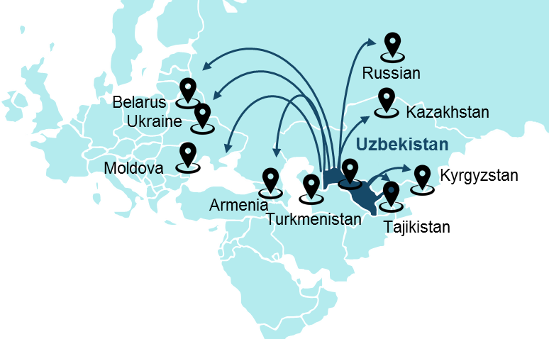
One of the most populated countries in the region with free trade access to vast neighboring potential
Neighbor countries with free trade agreements
Population, in million
Russia
144
Ukraine
Kazakhstan
Belarus
Other countries¹
28
Outreach of free trade agr.
245
Uzbekistan
Total market access
277
Comparable to Brazil
1 Other countries include Tajikistan (pending final signing of free trade agreement), Kyrgyzstan, Turkmenistan, Moldova, and Armenia
SOURCE: World Bank for 2016

Slide 7
Attractive tax incentives and free economic zones
We welcome foreign capital with significant tax incentives…
…and invite them to join one of the 21 FEZ to get full exemption from
0% income tax (for SMEs)
30%-50% income tax reduction²
0% VAT
Income tax and custom duties¹
Social infrastructure and uniform SME taxes
Compulsory contributions to the Road Fund
Steady decrease of tax burden (in % to GDP)
45%
41%
38%
30%
23%
20%
19%
Total implemented: 169 projects
Total amount: More than US$ 1 bn
1991
95
2000
05
10
15
2017

Slide 8
In two years time, a large-scale transformation and liberalization of the economy has been underway in Uzbekistan
December 2016
February
2017
September 2017
2018 year
2019 and beyond
Further implementation of numerous reforms
Continuation of reforms
Election of Shavkat Mirziyoyev as President
Uzbekistan Development Strategy for 2017–2021
Currency exchange liberalization
Green channel in airports
Simplification of the tax system, including the implementation of tax monitoring
Two-year moratorium on business inspections
Eliminating many types of business licences
Resetting customs tariffs
Many others…
Improvement of the customs system with the introduction of different corridors
tax burden reduction
Introduction of visa-free regimes for many countries
Business facilitation reforms
Many others…
In September 2016, the parliament elected Mr. Mirziyoyev as the interim president
On 4 December 2016, he won a presidential election, receiving 88.6% of the vote
The strategy outlines the government political, economic, and social priorities, including measures to liberalize the economy
The authorities linked the official exchange rate to the curb market rate and implemented a floating exchange rate, with free market exchange
Key to reforms

Slide 9
The Development Strategy for 2017–2021 (adopted in Feb '17) gave start of 5 priority reforms, including one for investors
It is envisaged that a separate state program for the implementation of initiatives in 5 reform areas will be approved yearly
The area, in which priority is given to attracting investments
Development of state governance
Rule of law & legal reforms
Development and liberalization of economy
Development of social sphere
Security, religious tolerance and interethnic harmony, foreign policy

Slide 10
In 2017–2018, the country managed to make notable progress in the chosen areas
29 laws were adopted
420 decrees and resolutions of the President of the Republic of Uzbekistan were adopted
29
Development of state governance
120 decrees
Rule of law & legal reforms
9
4
Liberalization of economy
22
54
27
Social sector
9 in the state society development
22 in judicial and legal system reforms
54 in development and liberalization of the economy
27 in social development
4 in security, religious tolerance and the implementation of constructive foreign policy
Security
Source: EBRD, State Investment Committee

Slide 11
Uzbekistan is moving ahead with reforms focusing on the first priority issues identified by the business community
Key directions for reforms
Status
Currency regulation
Liberalization of the foreign exchange market
Further steps to liberalize monetary policy
100
Improvement of legal framework in various areas of law: e.g. land allocation; stock exchange transformation; systematization of control procedures; enforcement of property rights; strengthening of fair competition; etc.
Legal environment
84%
Customs regulation
Unification and decrease of customs tariffs
Simplification of customs administration processes
45%
Tax system
Reduction of tax burden
Elimination of complex and unfair procedures
35%
Reform of State governance
Efficiency improvement for state bodies to eliminate inconsistencies; bureaucracy
Implementation of eGov system
Share of investors citing the barrier as critical
(based on interviews with internal and external investors)
Implementation progress
Source: investor interviews

Slide 12
One of the main milestones of economic reforms was the liberalization of the currency exchange regulations
Decree of the President dated 09/02/2017
Key elements of the reform
The impact of reforms
Free purchase and sale of foreign currency by individuals and legal entities
I
Equal competitive conditions for all players by reduction of administrative interference in the economy
II
Strengthening of regional and international economic cooperation
Removal of requirements for compulsory sale of foreign currency for exporters
III
Improvement of business activity and investment climate
Commercial banks are granted the right to determine commissions on currency exchange for export revenues
IV
Attraction of foreign direct investments (FDIs)

Slide 13
A new system of land allocation & construction regulations is among the key elements of the legal & rule of law reform
In the course of discussion with the government bodies and agencies
Key elements of the reform
The impact of reforms
The implementation of a new simplified & quicker process for construction approvals
I
Reducing the time taken by the process for land allotment and construction approvals by 30–40%
II
Providing investors with the information about the list of available land lots, their full effective cost and relevant documentation
Creation of a new system of land allocation via electronic auctions
III
Ensuring the fair compensation to the state budget for use of land
Updating construction regulations via adoption of Construction Codes and Regulations based on Eurocodes (following example of Kazakhstan)
IV
Solving the issues related to obsolete construction regulations, which hinder the use of modern construction technologies

Slide 14
Customs reform reduces the tariff burden while simplifying and accelerating administrative procedures
Key elements of the reform
The impact of reforms
Reviewing the rates of customs duties with the aim to reduce them
I
Improvement of customs tariff regulation, incl. reducing the likelihood of corruption
Creating a unified approach to the setting the rates of and levying customs charges
II
Intensification of negotiations with the WTO standards and best practices
Introduction of a risk management systems at customs bodies with opening yellow, red, green and blue lines
III
Reduction of time taken by paperwork and procedural formalities by 3–5 times
Simplifying and accelerating customs processes (e.g. customs valuation, border crossing, etc.) and building mordern customs offices/posts
IV
Decreasing the costs of customs procedures by 30–70%
Reduction of the frequency of and time spent on the issuance of the requested authorization documents

Slide 15
State governance reform improves the coherence of the work of state bodies and reduces pressures on business
Key elements of the reform
The impact of reforms
Improvement of institutional, organizational and legal framework for government bodies and authorities
In total, 46 governemnt bodies were reshaped or merged; 6 abolished
I
Clear specification of tasks and responsibilities of executive bodies
II
Structures, tasks and functions revised for Office of the President, the Cabinet of Ministers, 20+ Ministries
Reduction of administrative influence on the economy & investors
Improvement of overal governance and interaction of executive authorities
Better coordination between state bodies and local administrations
III
Introduction of modern forms of strategic planning, innovative ideas, developments and technologies
III
Combination of two government offices and creation of the Ministry for investments and foreign trade of the Republic of Uzbekistan
Formation of an effective system of professional civil services (e.g. eGov)

Slide 16
Reforms to provide comprehensive assistance to foreign and domestic investors for investment activities
Key elements of the reform
The impact of reforms
Establishment of The direct investment fund of the Republic of Uzbekistan
Attracting foreign direct investment and innovation technologies, as well as investment promotion by obtaining and emission shares, financing projects and etc.
I
Creation of the Uzbek-Emirates investment company
II
Issuing a residence permit in the Republic of Uzbekistan in a simplified manner for a period of 10 years for investors and their family members investing more than US3 million dollars;
Introduction of an investment visa for investors and their families
Coordination for prompt elimination of problems coming out during implementation of investment projects
III
Introduction of modern technologies for monitoring the implementation of investment projects
III
Removing current barriers and simplifying business processes
Creation of favorable business conditions corresponding to the indicators of the top 20 countries in the ranking of World Bank “Doing Business”

Slide 17
Main Takeaways from the Presidential Decree on “Improvement of the investment climate“
Decree of the President dated 01/08/2018
Decree point
Details
Relaxation of visa requirements for foreign investors and their employees
Foreign investors can also be granted the status of an Honored Citizen
Expansion of regional authorities to provide land for foreign investors
Regional authorities can now effect a contract for investments up to $10M and provide land of up to 5000 sq m
Minimum shareholders equity lowered from 600M som to 400M som (~$51k)
Minimum level of foreign share for foreign investment company status is lowered to 15%
Loosening of legal requirements for enterprises with foreign shareholders

Slide 18
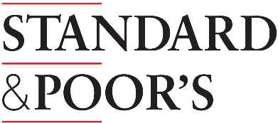
Credit rating agencies’ assessment for Uzbekistan and Uzbeksitan’s first Eurobonds
Agency | Uzbeksitan’s Rating | Rating countries
Uzbekistan in international debt markets
 | BB- stable | Brazil Dominican Georgia
 | B1 stable | Armenia Costa Rica Montenegro
 | BB- stable | Brazil Dominican Georgia Greece
$1 billion Eurobonds in first foray into international debt markets
Uzbekistan sold
4.75 percent on five-year paper
The deal priced
with a yield
5.375 percent on 10-year notes
Investors bid for more than
$5.5 billion of the bonds
Azerbaijan
Brazil
Kazakhstan
Turkey
5
point
Notes:
Источник информация: https://www.bloomberg.com/news/articles/2019-02-13/uzbekistan-emerges-from-isolation-with-1-billion-eurobond-sale
https://tradingeconomics.com/uzbekistan/rating

Slide 19
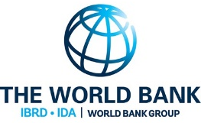
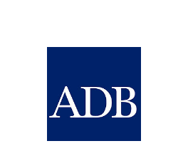
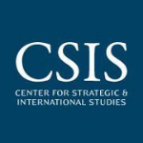
The international community acknowledges the recent significant progress in Uzbekistan
The first concrete steps on improvement of quality of economic data and increase of their transparency.
IMF Spokesperson
The World Bank is ready to significantly increase its presence in Uzbekistan and to support the reforms in the country
Kristalina Georgieva
World Bank CEO
We are in a great hurry, we are striving to expand and deepen our presence in Uzbekistan as soon as possible.
Philip Bennet
Former First Vice-President of EBRD
The Action Strategy has much in common with the United Nations Sustainable Development Goals and the wider 2030 Agenda for Sustainable Development, and can form the basis for even greater cooperation between your country and the United Nations.
Antonio Guterres, UN Secretary General
ADB, in accordance with the government's strategy, is planning to provide USD 2.6 billion in sovereign loans in 2017–2019, to increase non-sovereign transactions through equity investments and private loans.
Takehiko Nakao
The President of ADB
If you look back in history, you can see that Uzbekistan has always played a special role in Eurasia.While people in other parts of the region had a nomadic lifestyle, civilization was already flourishing in Uzbek cities.
Jonathan Hilman, The Director of the Asia Liaison Project at the Center for Strategic & International Studies (USA)
The Action Strategy, developed by the initiative of the President Shavkat Mirziyoyev, is a very serious and bright program, it reflects ideas of the United Nations and reforms aimed at ensuring human rights.
Zaid Raad Al-Hussein, Un high commissioner for human rights
Source: EBRD, State Committee of Uzbekistan for Investments

Slide 20
World Bank Doing Business ranking: 90 points improvement in the past 5 years
World Bank: Doing Business ranking change
2012
2019
Improvements in investment climate
▪ Development strategy 2017-2021 aimed at opening and liberalising the economy and improving investment climate
▪ Tax incentives for foreign direct investments, including 20 free economic zones
▪ Comprehensive support provided to foreign investors by the State Committee for Investments and the Chamber of Commerce and Industry of Uzbekistan, including consulting services and legal assistance
Recognition of success
▪ Measures taken by the government drive material improvements in most topics of Doing Business ranking. Since 2012 most significant changes occurred to Starting a Business, Getting Electricity, Getting a Credit, Paying Taxes and Registering Property
▪ The World Bank named Uzbekistan one of the top 10 global improvers in 2017
157 Comoros
158 Suriname
159 Mauritania
160 Afghanistan
161 Cameroon
162 Togo
164 Iraq
165 Lao PDR
166 Uzbekistan
71 Ukraine
72 Greece
73 Indonesia
74 Mongolia
75 Jamaica
76 Uzbekistan
77 India
78 Oman
79 Panama
Rise by 90 positions since 2012– Now 76th place /190 countries

Slide 21
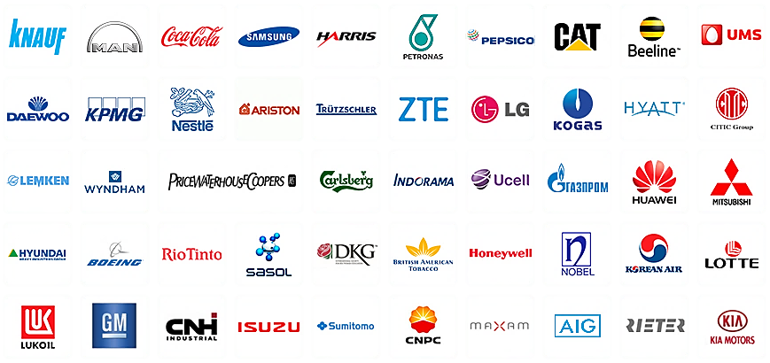
Companies with FDI in Uzbekistan

Slide 22
Textile industry
Sportswear
Cotton fabrics
Uniforms
Garments
Shoes
Wool blend fabric
Leather products
Apparel
Baby clothes
Carpets and rugs

Slide 23
Food industry
Confectionary
Fast foods by using freeze-dried pieces of fruit and vegs
Ketchup
Fast freeze food
Dry concentrated broths
Packaging containers
Deep processing of fruit and vegetables

Slide 24
Pharmaceuticals & medical equipment
Medicaments for cardiovascular diseases
Disposable tests
Anabolic medicines
Finished medicaments
Various diseases vaccines
Medical gloves
Medical equipment

Slide 25
Construction & Building Materials
29806E
Glass-crystallite
Sanitary ceramics
Locks (door, wall)
Natural stone (marble)
Wood-polymer composite products
Thermal insulating materials
Glass products (glasses, wine glasses)

Slide 26
Electrical engineering
LED lighting devices
Refrigerators
Microwaves
Washing & dishwashing machines
Small household appliances

Slide 27
Mechanical engineering
Industrial deep-well pumps
LPG equipment for liquefied natural gas
Textile (knitting) machinery
Over-lock machines
Electric tools (drills, grinders, screwdrivers)
Heating systems

Slide 28
Oil & Gas Industry
Polymers
Polyethylene foam
Conduction of exploration works
Development of petroliferous shale deposits

Slide 29
Chemical industry
Ammonia and urea
Synthetic washing detergents
Cosmetics
Plastic accessories for light industry
Household water filters
Toys for children

Slide 30
Automobile Industry
Shock absorbers
Braking pads
Safety belts
Spark plugs
Oil filters
Components of automotive power-train

Slide 31
Ministry for investments and foreign trade ensures "front to end" support for current and potential investors
Preparation of investment proposals & business cases
Attracting foreign investors
Supporting foreign investors
Search for, study and evaluation of the project business cases
Identification of funding sources for projects
Preparation of investment proposals for investors
Finding investors for specific strategic projects
Working with projects initiated by investors
Engaging international financial organizations
Promoting investment activity
Assisting and supporting investors until the completion of their projects
Collecting feedback and responding to it (“Voice of investors")
Improving the investment climate in the relevant areas according to the "Voice of investors"

