Slide 1
TDAP’s 1st International Virtual Textile Exhibition
February 1-5, 2021
virtualtexpo.tdap.gov.pk
Organized by
Managed by

Slide 2
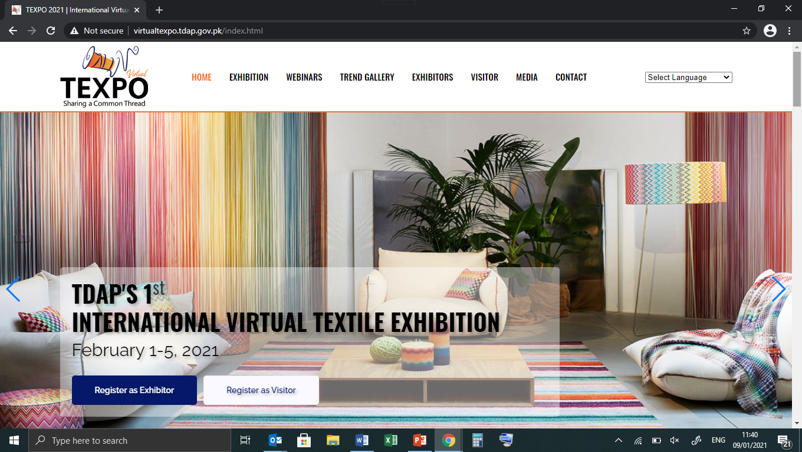
TDAP's 1st International Virtual Textile Exhibition
February 1-5, 2021 | virtualtexpo.tdap.gov.pk
Trade Development Authority of Pakistan (TDAP) is organizing the 1st International Virtual Textile Exhibition from February 1-5, 2021. The main objective of the event is to present country's quality and diverse textile products to the international buyers.
Started in 2016, TEXPO is the first of its kind, to venture into the virtual arena of exhibitions. The 5-day exhibition will be open round-the-clock on virtual basis for the convenience of visitors which may visit as per their connivance of time zone.
Leading brands and exporters from all over Pakistan are participating in the event as exhibitors.
This step-by-step guide will give you a glimpse of the platform and available options. Video Guides will also be available on Texpo website and Virtual platform to facilitate a smooth journey to Virtual Texpo 2021.
OPTION# 01

Slide 3
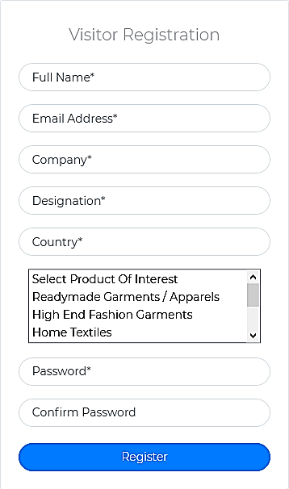
TDAP's 1st International Virtual Textile Exhibition
February 1-5, 2021 | virtualtexpo.tdap.gov.pk
Step-1 – Register as Visitor
Simple Visitor Registration process. To Register, visit http://virtualtexpo.tdap.gov.pk/visitor.html
Step-2 – Confirm Your Registration
Upon registration, a Confirmation Email will be received with relevant links.
OPTION# 01

Slide 4
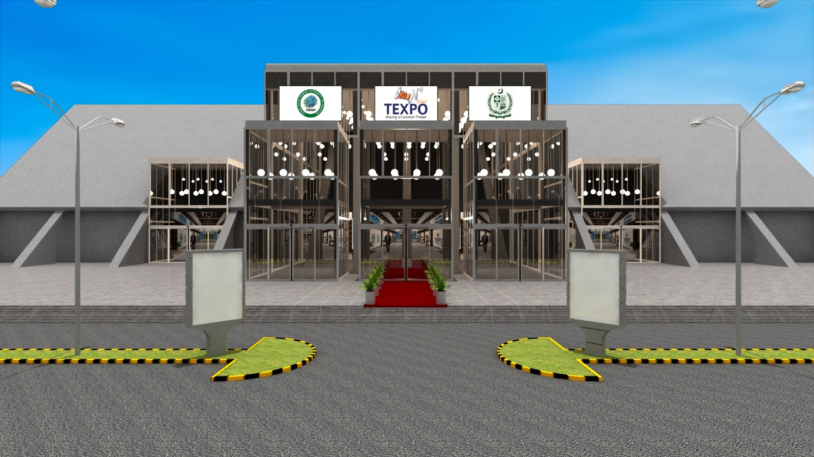
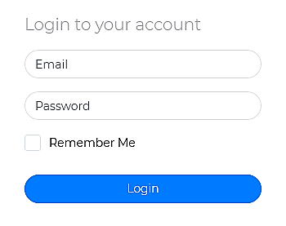
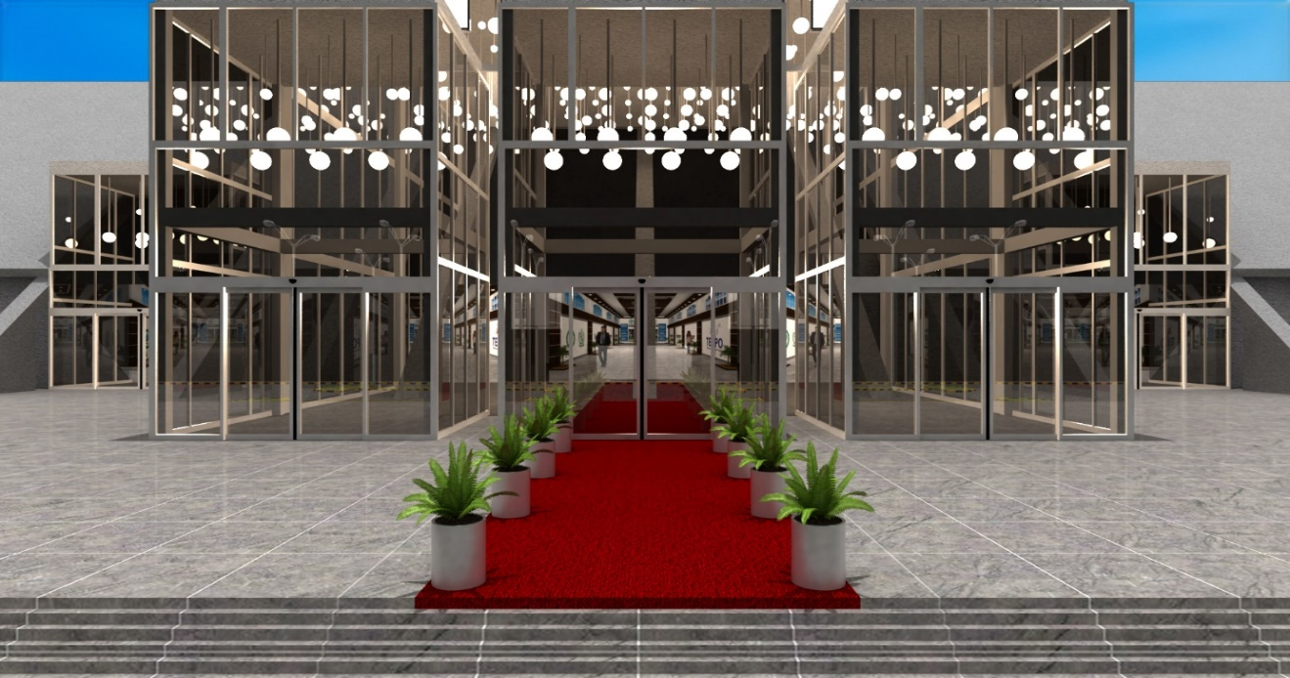
TDAP's 1st International Virtual Textile Exhibition
February 1-5, 2021 | virtualtexpo.tdap.gov.pk
Step-3 – Log in to the Virtual Exhibition
Animated Virtual Expo Center Entrance once you log in
Visitor can log in the Virtual Platform from February 1, 2021
OPTION# 01

Slide 5
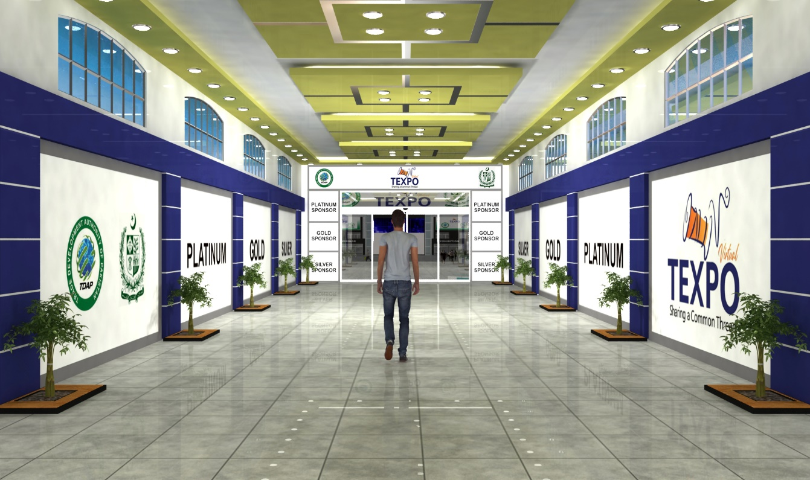
TDAP's 1st International Virtual Textile Exhibition
February 1-5, 2021 | virtualtexpo.tdap.gov.pk
Upon log in, an Animation will take the Visitor from Entrance to the Main Lobby
passing through a branded corridor
OPTION# 01

Slide 6
TDAP's 1st International Virtual Textile Exhibition
February 1-5, 2021 | virtualtexpo.tdap.gov.pk
Step-4 – Arrive in Lobby
From the Main Lobby, Visitor is provided control to navigate as per his choice for the following activities:
Exhibition
Webinar
Trend Gallery
Information Desk will provide information about Exhibitor List, Webinar Schedule and details of other activities
OPTION# 01

Slide 7
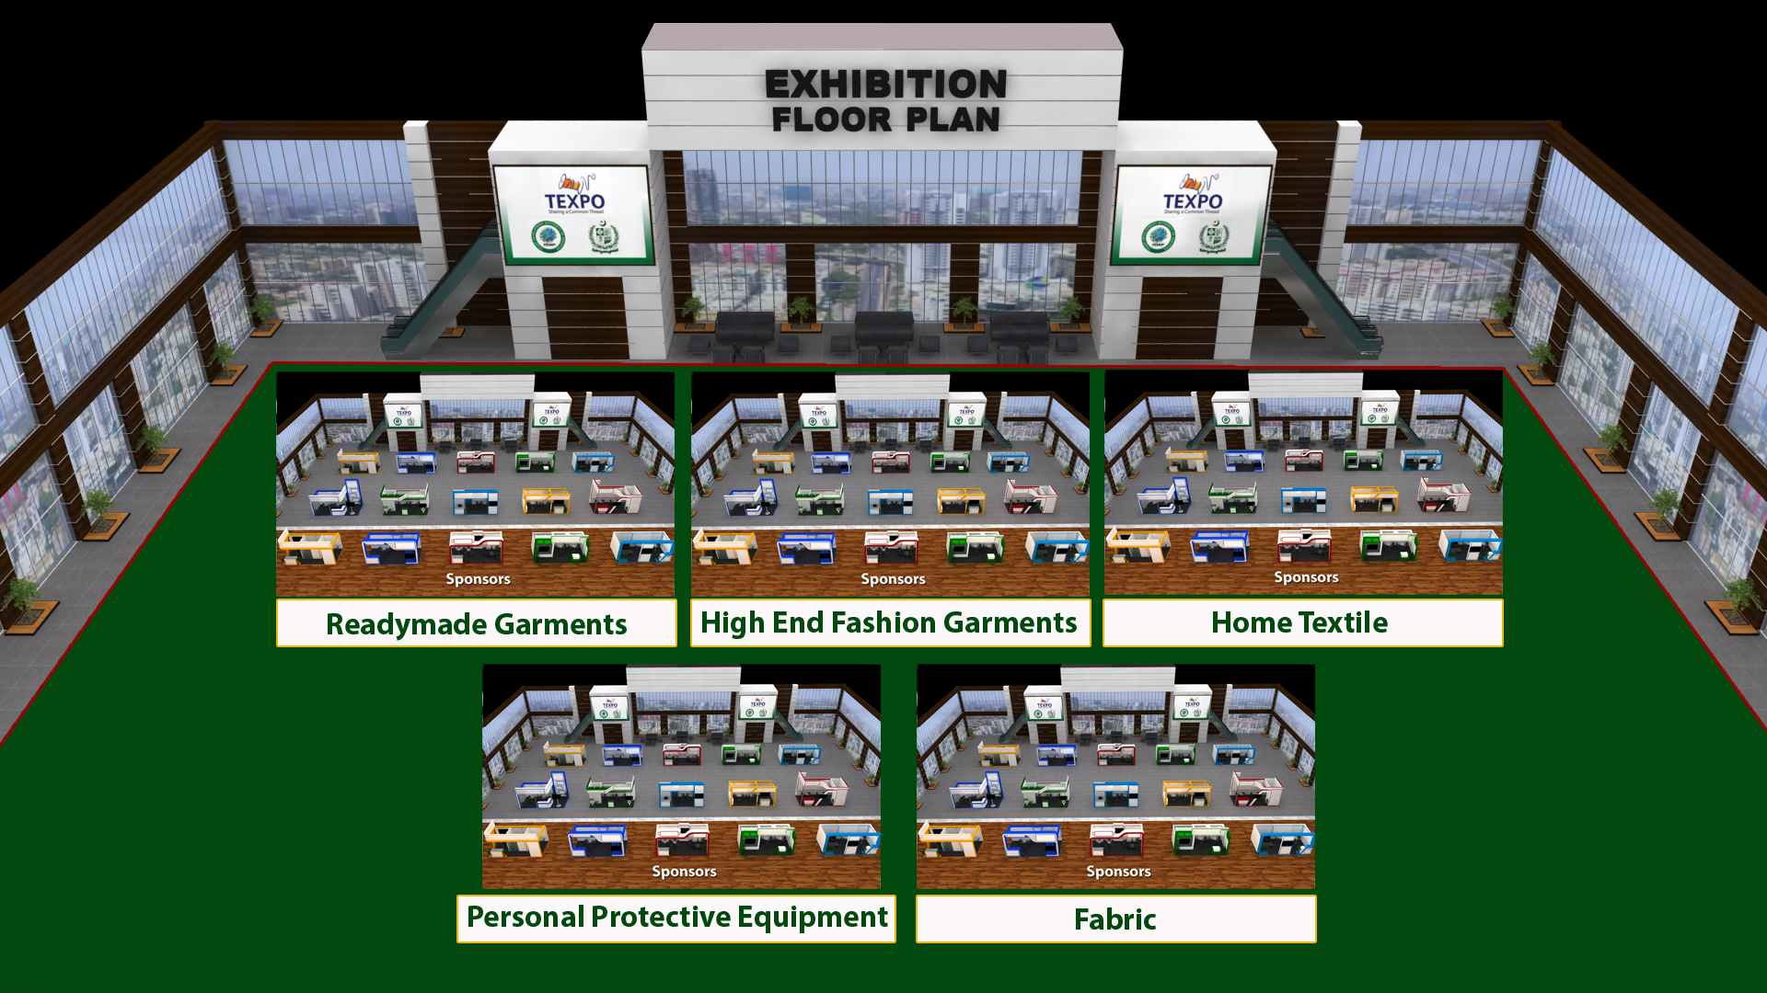
TDAP's 1st International Virtual Textile Exhibition
February 1-5, 2021 | virtualtexpo.tdap.gov.pk
Visitor may visit Product Hall of his interest
Step-5 – Visit Exhibition
On selection of Exhibition, Visitor will have the view of Exhibition Floor Plan
Step-6 – Select Hall
You may select Exhibition Hall of your preference by clicking the relevant hall icon
OPTION# 01

Slide 8
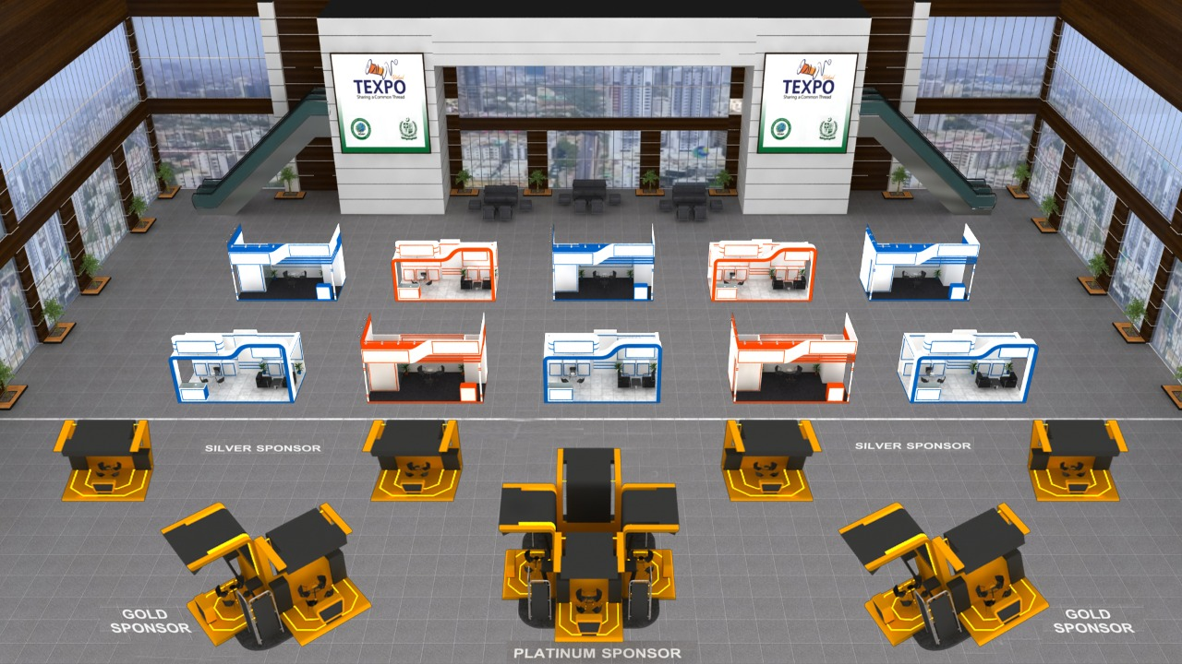
TDAP's 1st International Virtual Textile Exhibition
February 1-5, 2021 | virtualtexpo.tdap.gov.pk
Visit booths and interact with the Exhibitors
Step-7 – Select and Visit Booths
The selected Exhibition Hall will appear on selection and Visitor may visit virtual Booths and can review company and product details with multiple communication options.
The following slides will elaborate the options available to Visitor on virtual booths.
OPTION# 01

Slide 9
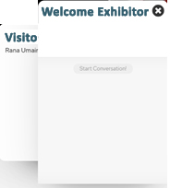
TDAP's 1st International Virtual Textile Exhibition
February 1-5, 2021 | virtualtexpo.tdap.gov.pk
View of Booth
OPTION# 01

Slide 10
TDAP's 1st International Virtual Textile Exhibition
February 1-5, 2021 | virtualtexpo.tdap.gov.pk
Active Visitors to be visible to Exhibitors with an option of invitation to their booths
Instant Messenger
From Exhibitor’s End:
Real-time
List of Visitors
on Booth
From Visitor’s End:
Real-time
List of
Online Attendants
on Booth
OPTION# 01

Slide 11
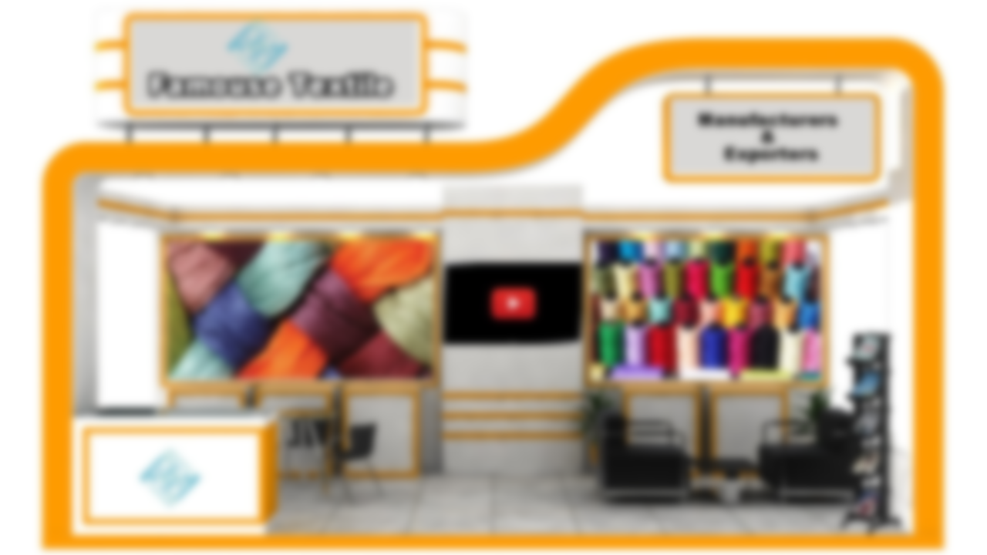
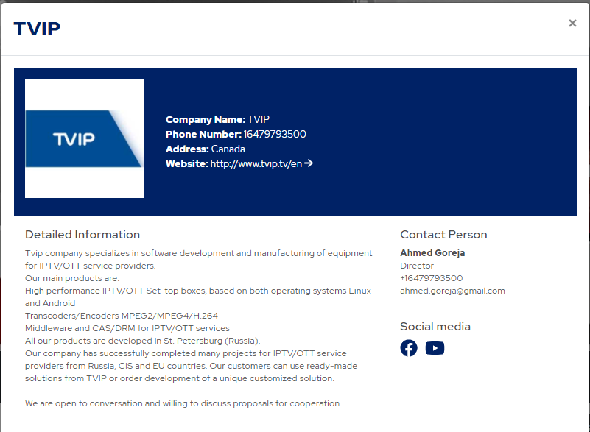
TDAP's 1st International Virtual Textile Exhibition
February 1-5, 2021 | virtualtexpo.tdap.gov.pk
Visitor may have access to Exhibitor’s Profile
OPTION# 01

Slide 12
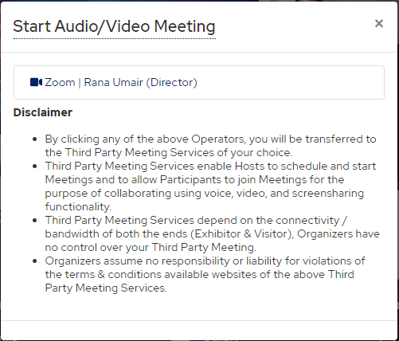
TDAP's 1st International Virtual Textile Exhibition
February 1-5, 2021 | virtualtexpo.tdap.gov.pk
Ease of Communication between Visitor and Exhibitor
Exhibitors may have 5 different Meeting Rooms Embedded for Audio/Video Meetings with their Visitors
Zoom | Google Meet | Microsoft Teams | Skype | WeChat

Slide 13
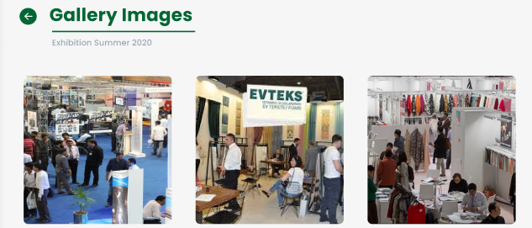
TDAP's 1st International Virtual Textile Exhibition
February 1-5, 2021 | virtualtexpo.tdap.gov.pk
Visitor may browse Albums made available by Exhibitors
OPTION# 01

Slide 14
TDAP's 1st International Virtual Textile Exhibition
February 1-5, 2021 | virtualtexpo.tdap.gov.pk
Visitor may Read/Download the Documents made available by Exhibitor
OPTION# 01

Slide 15
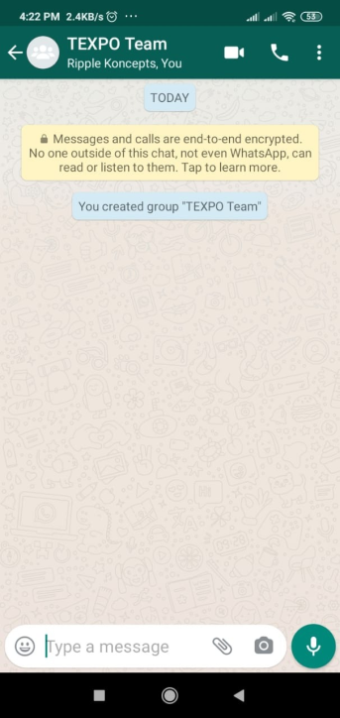
TDAP's 1st International Virtual Textile Exhibition
February 1-5, 2021 | virtualtexpo.tdap.gov.pk
Visitor may communicate with Exhibitor by joining Whatsapp Group
Embedded WhatsApp Group of Exhibitor with Extended Team Members to engage with Visitors
OPTION# 01

Slide 16
TDAP's 1st International Virtual Textile Exhibition
February 1-5, 2021 | virtualtexpo.tdap.gov.pk
Visitor’s Dashboard

Slide 17
TDAP's 1st International Virtual Textile Exhibition
February 1-5, 2021 | virtualtexpo.tdap.gov.pk
Step-8 – Arrive in Lobby
From the Dashboard, Visitor can navigate in to the Lobby and restart the journey. Same will be the option if you log in again.
OPTION# 01

Slide 18
Register Now!
http://virtualtexpo.tdap.gov.pk/visitor.html
Organized by
Managed by

