Slide 1

IGJS Jaipur 2027
An extraordinary sourcing opportunity for the delegates from China.
16–18 April 2027 | Novotel, JECC, Jaipur, India

Slide 2
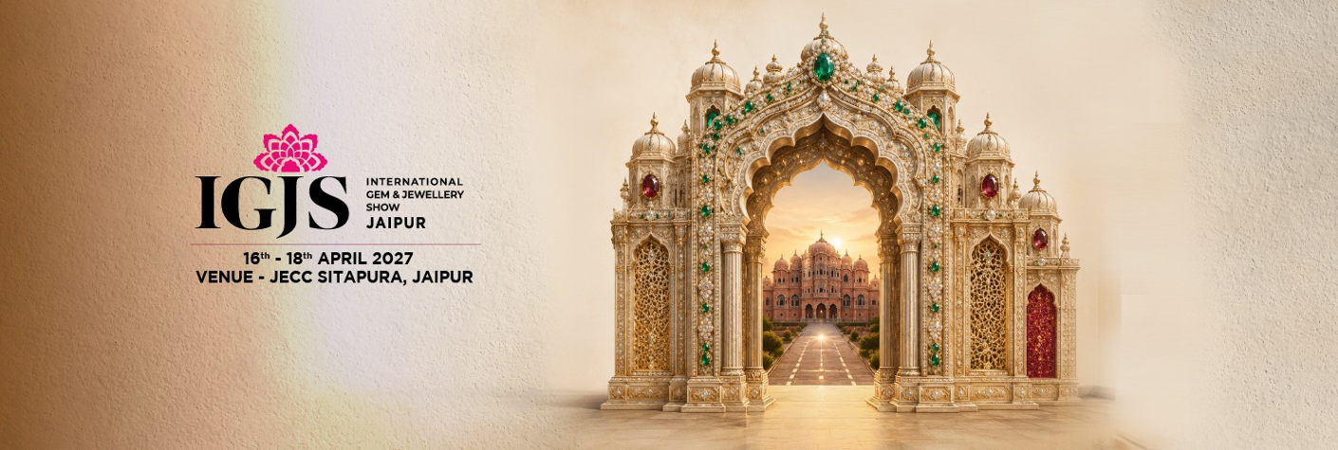

The Sourcing Opportunity
A direct and exclusive bridge between China’s’s jewellery of excellence and India's leading producers and cutters of diamonds and gems.

Slide 3



Tailor-made sourcing
Direct Access to Producers
IGJS Jaipur is the go-to B2B platform designed to connect the most qualified international buyers with India's leading companies.
Indian fine-jewellery collections
with diamonds and gemstones
Direct meeting with 240 leading producers and exporters of India.
Instant comparison of design, quality and prices in a single visit.
Development of customized collections and private-label solutions.
Structured B2B meetings thanks to a dedicated matchmaking service.

Slide 4

IGJS Key Numbers
A B2B High-Intensity Event
The International Gem & Jewellery Show brings together the entire production chain in a highly selected and efficient business context.
240
• 600+ Hosted Buyers: from the USA, Europe, the Middle East, Latin America, CIS Countries and Asia.
Producers of Excellence
• 3 Production Centers: Jaipur, Mumbai and Surat united under one roof.

Slide 5









Product Categories
Loose Natural & Lab-Grown Diamonds
Coloured Gemstones
Finished Jewellery
Jaipur is the world capital for cutting emeralds, rubies and sapphires, offering priority access to top-quality precious and semi-precious stones.
Commercial and high-end collections in gold, platinum and silver, set with diamonds and coloured stones for the Thailand market for cataring western countries .
A wide selection of loose natural diamonds in every carat weight and cut, alongside the latest innovations in lab-grown diamonds.

Slide 6
Hosted Buyer Experience
An exceptional welcome package designed by GJEPC to ensure a comfortable, productive stay for China’s leading delegates.

Slide 7
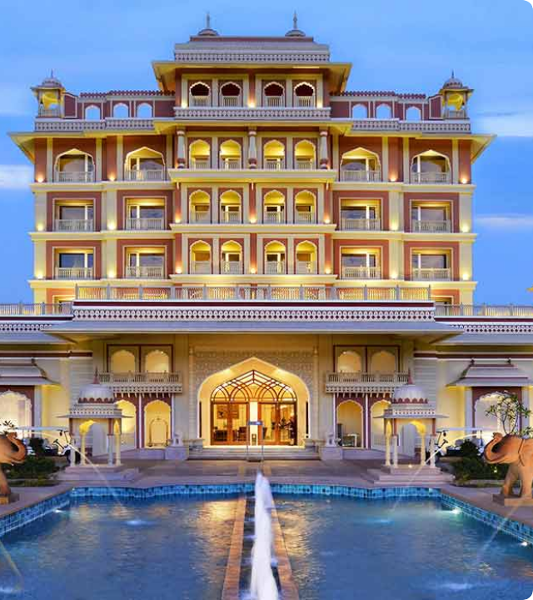
Flight & 5-Star Hotel Stay
Reserved Luxury Hospitality
To facilitate the participation of China buyers recommended by Embassy, GJEPC offers these exclusive benefits:
3-Night Stay at a 5-Star Hotel: Complimentary accommodation from 15 to 17 April 2027, with meals included on fair days.
Partial Airfare Reimburesment

Slide 8

Jaipur Heritage Tour
Discover the Pink City
In addition to the business sessions, delegates from China will have the opportunity to experience Jaipur's extraordinary cultural heritage.
Amber Fort & City Palace: Masterpieces of Rajasthani royal architecture.
Hawa Mahal & Jal Mahal: The city's iconic and historical landmarks.
Jantar Mantar: An ancient astronomical observatory and UNESCO World Heritage Site.
Traditional markets of gems, handicrafts and local manufacturing.

Slide 9
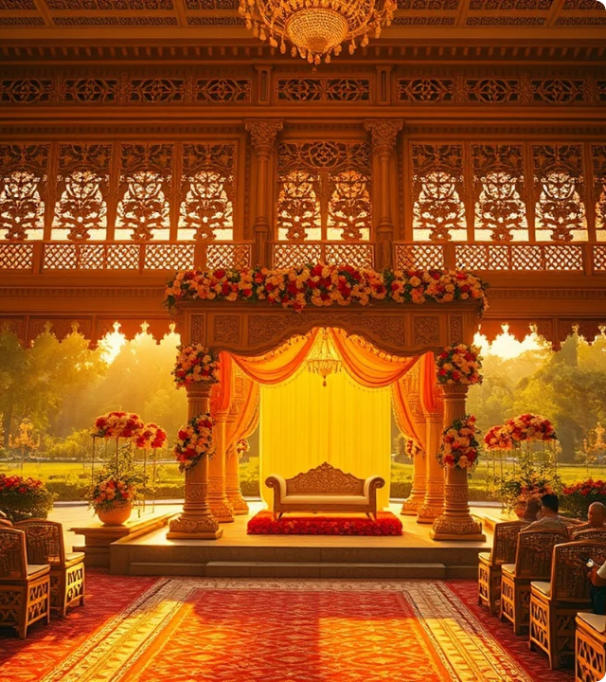

Exclusive Gala Evening
VIP Culture & Networking
A central moment of the event will be the Gala and Networking Evening, designed to celebrate the link between China and Indian jewelry.
• Traditional Welcome: Rajasthani royal welcome and hospitality ceremony.
• Cultural Shows: Live performances by renowned artists.
• Gourmet Dinner: A journey into the refined Indian culinary tradition.
The perfect environment to consolidate business relationships in an elegant atmosphere.

Slide 10









The production hubs of India
Jaipur
Mumbai
Surat
The world capital of colored gem cutting and traditional goldsmithing.
Primary hub for the manufacture of high jewellery and contemporary design.
The global centre for cutting and polishing 90% of the world's diamonds.

Slide 11

Why Join IGJS
Service / Benefit | Standard Trade Visitor | Federpreziosi Delegation
B2B Exhibitor Access | General access | Curated priority matchmaking
5-Star Hotel Stay | Paid | 3 complimentary nights (15–17 April)
Culture & Gala Evening | Not included | VIP gala dinner

Slide 12


We look forward to seeing you at IGJS 2027
We will be honoured to welcome Thailand delegation
for an unforgettable commercial and cultural experience.
Official website: intl.gjepc.org/jaipur
Registration: intl.gjepc.org/visitor-registration/igjs-jaipur-2027
For more details: Mr. Varun Chulate - + 91 9833654932, varun.chulate@gjepcindia.com

